Slide 1
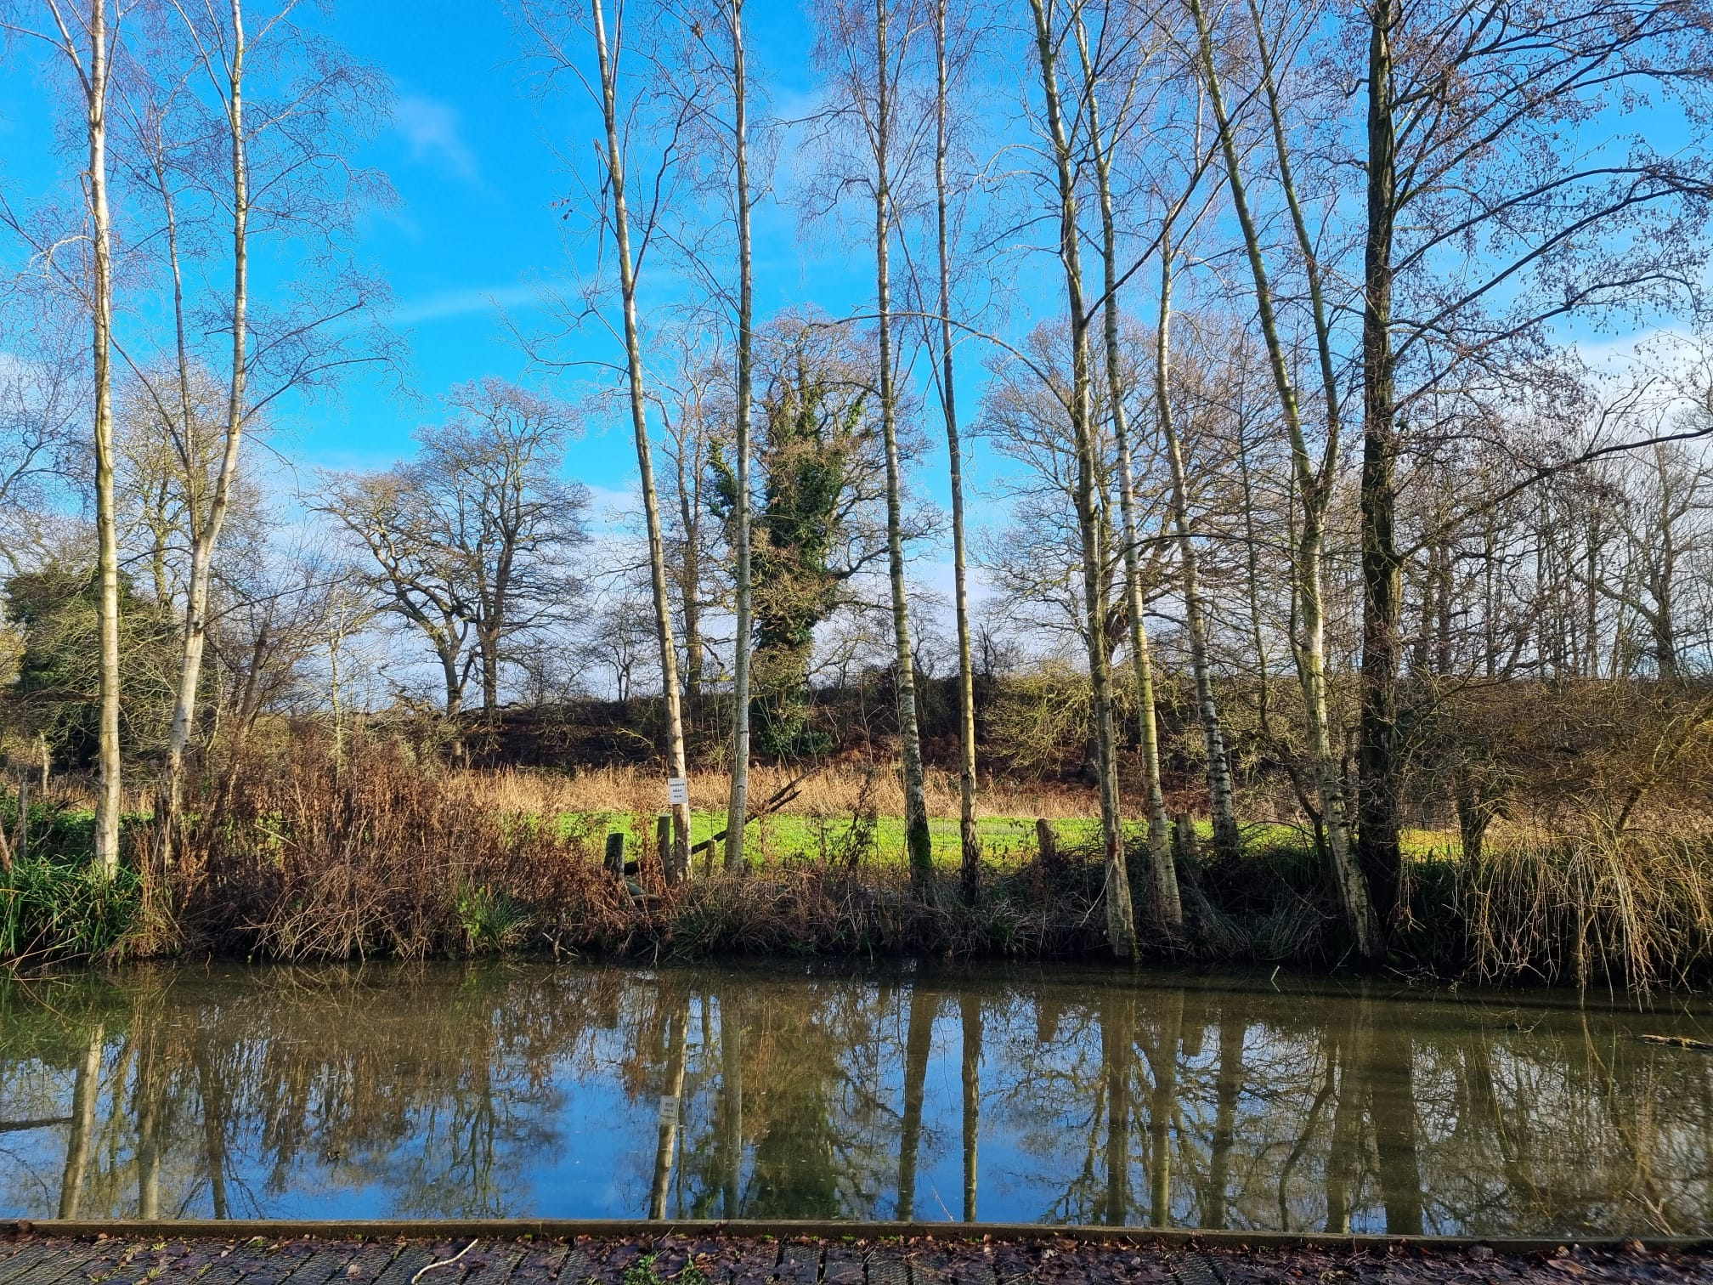
Cremer’s Meadow 2025-6

Slide 2
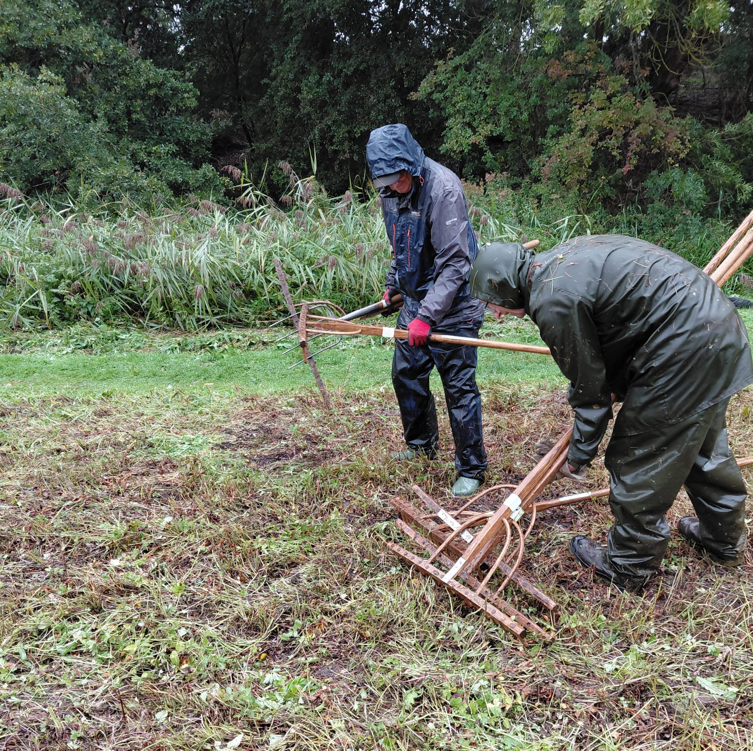
It has been another very busy year for the Friends of Cremer’s Meadow.

Slide 3
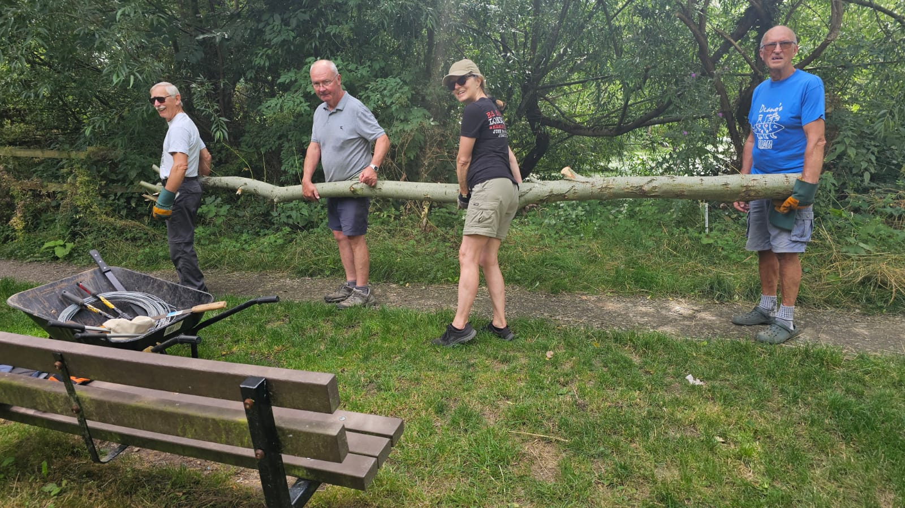

Slide 4
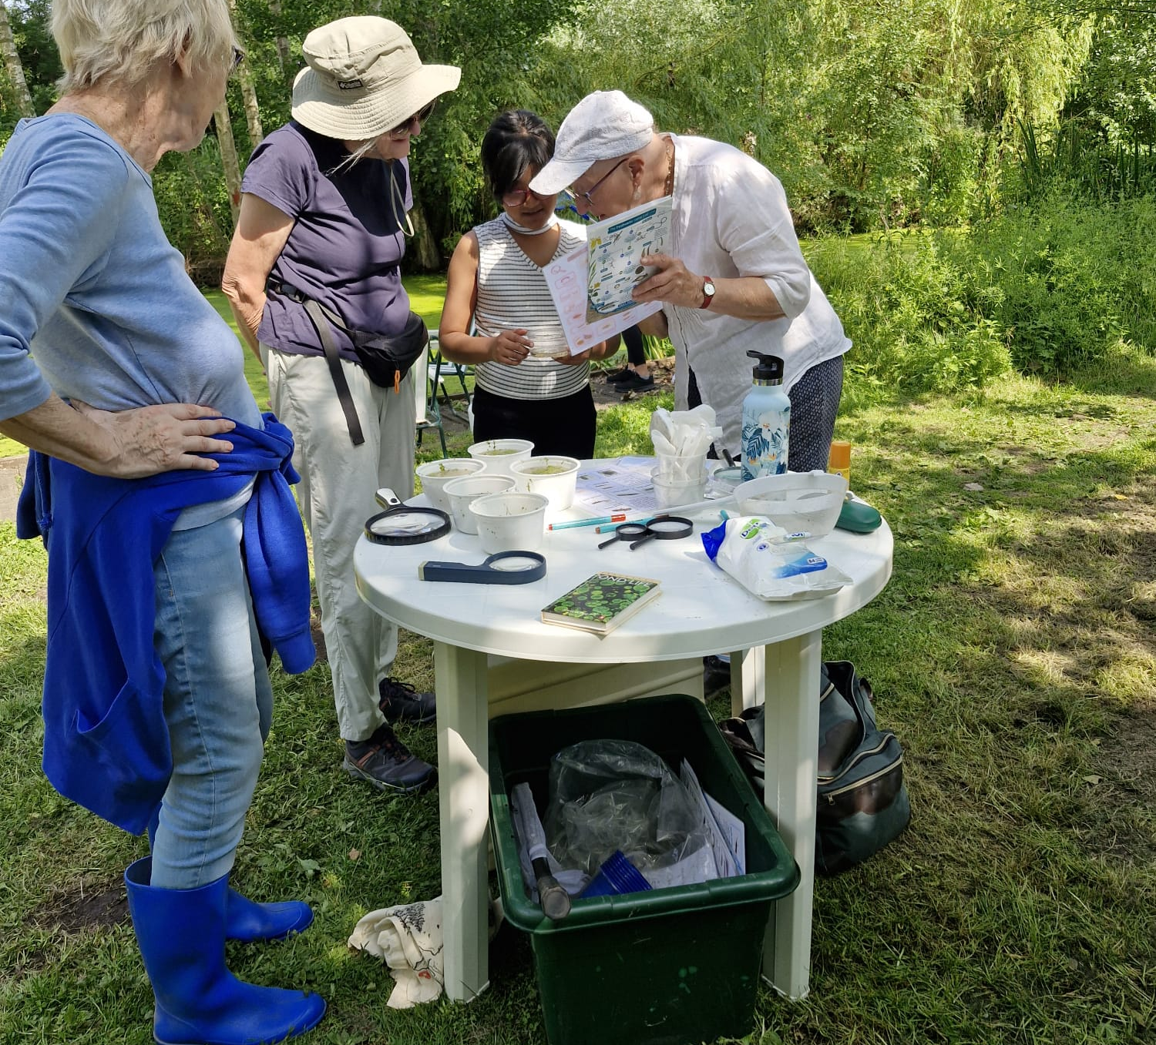
Open Day June 2025

Slide 5
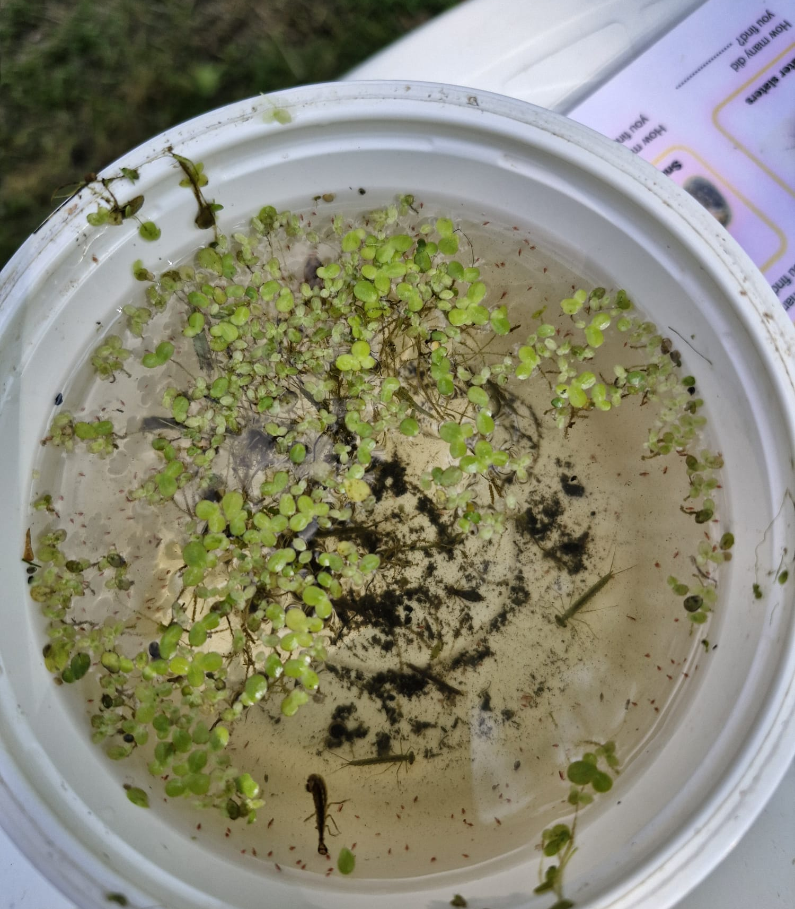
Pond soup!

Slide 6
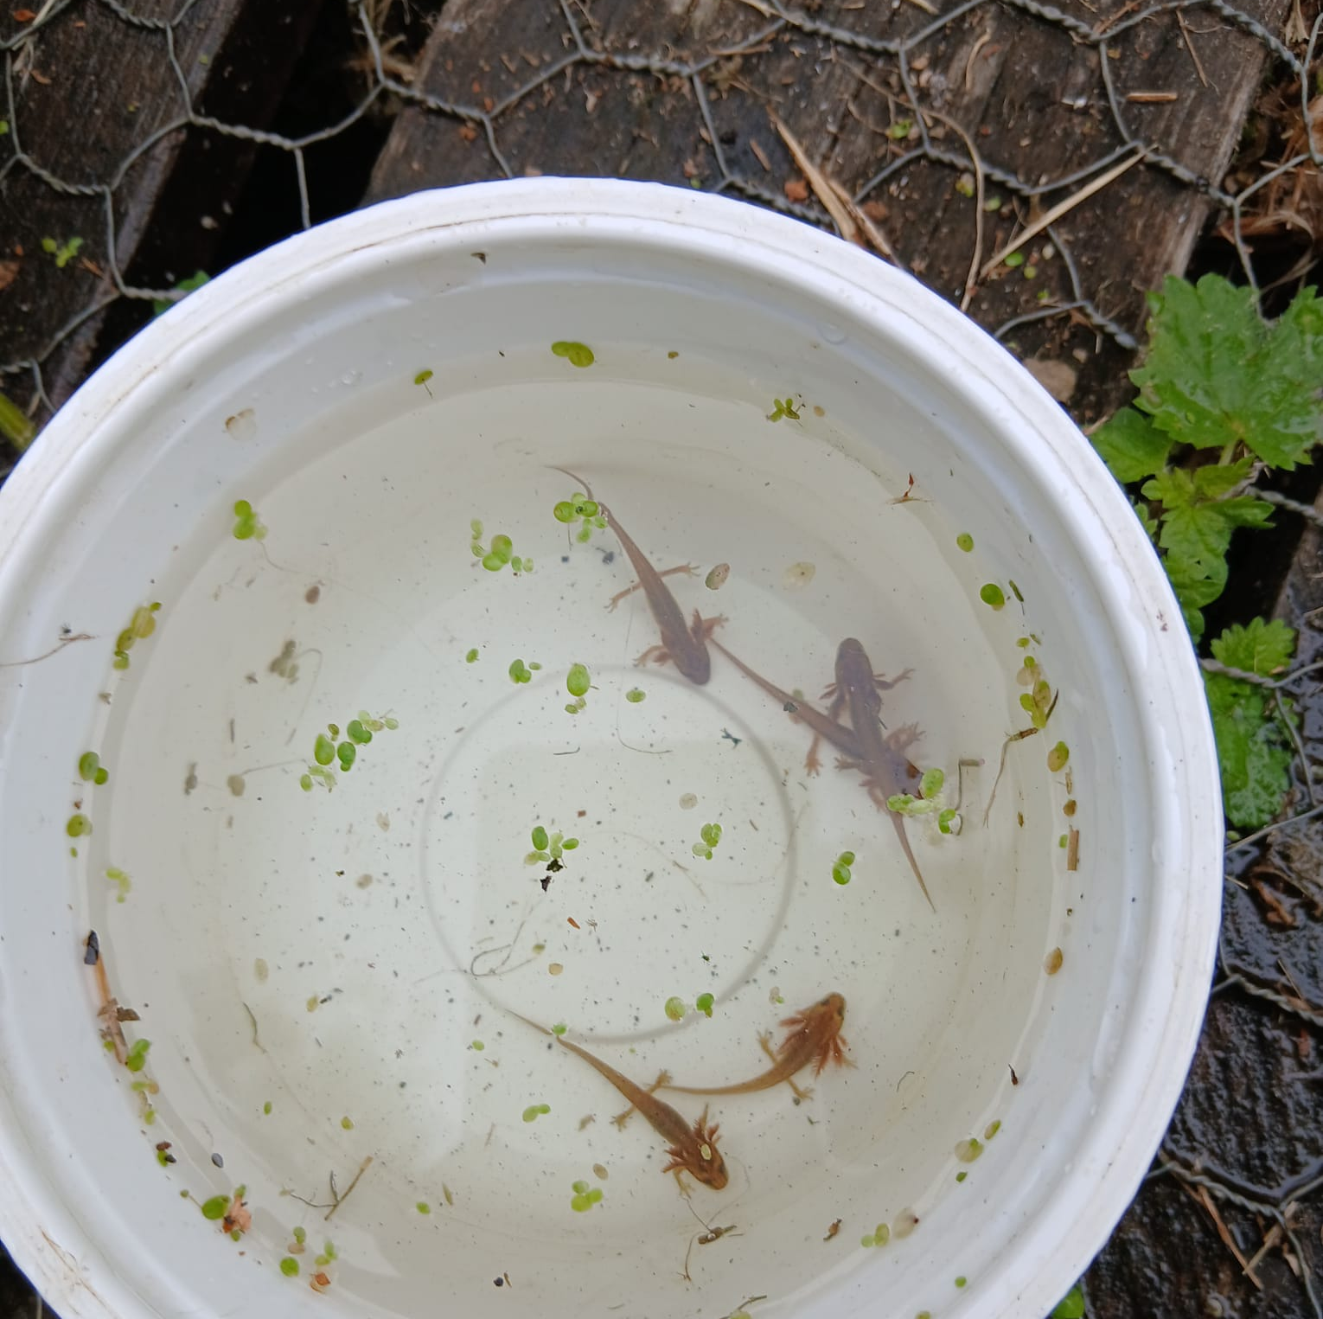
Quite a few newts discovered.

Slide 7
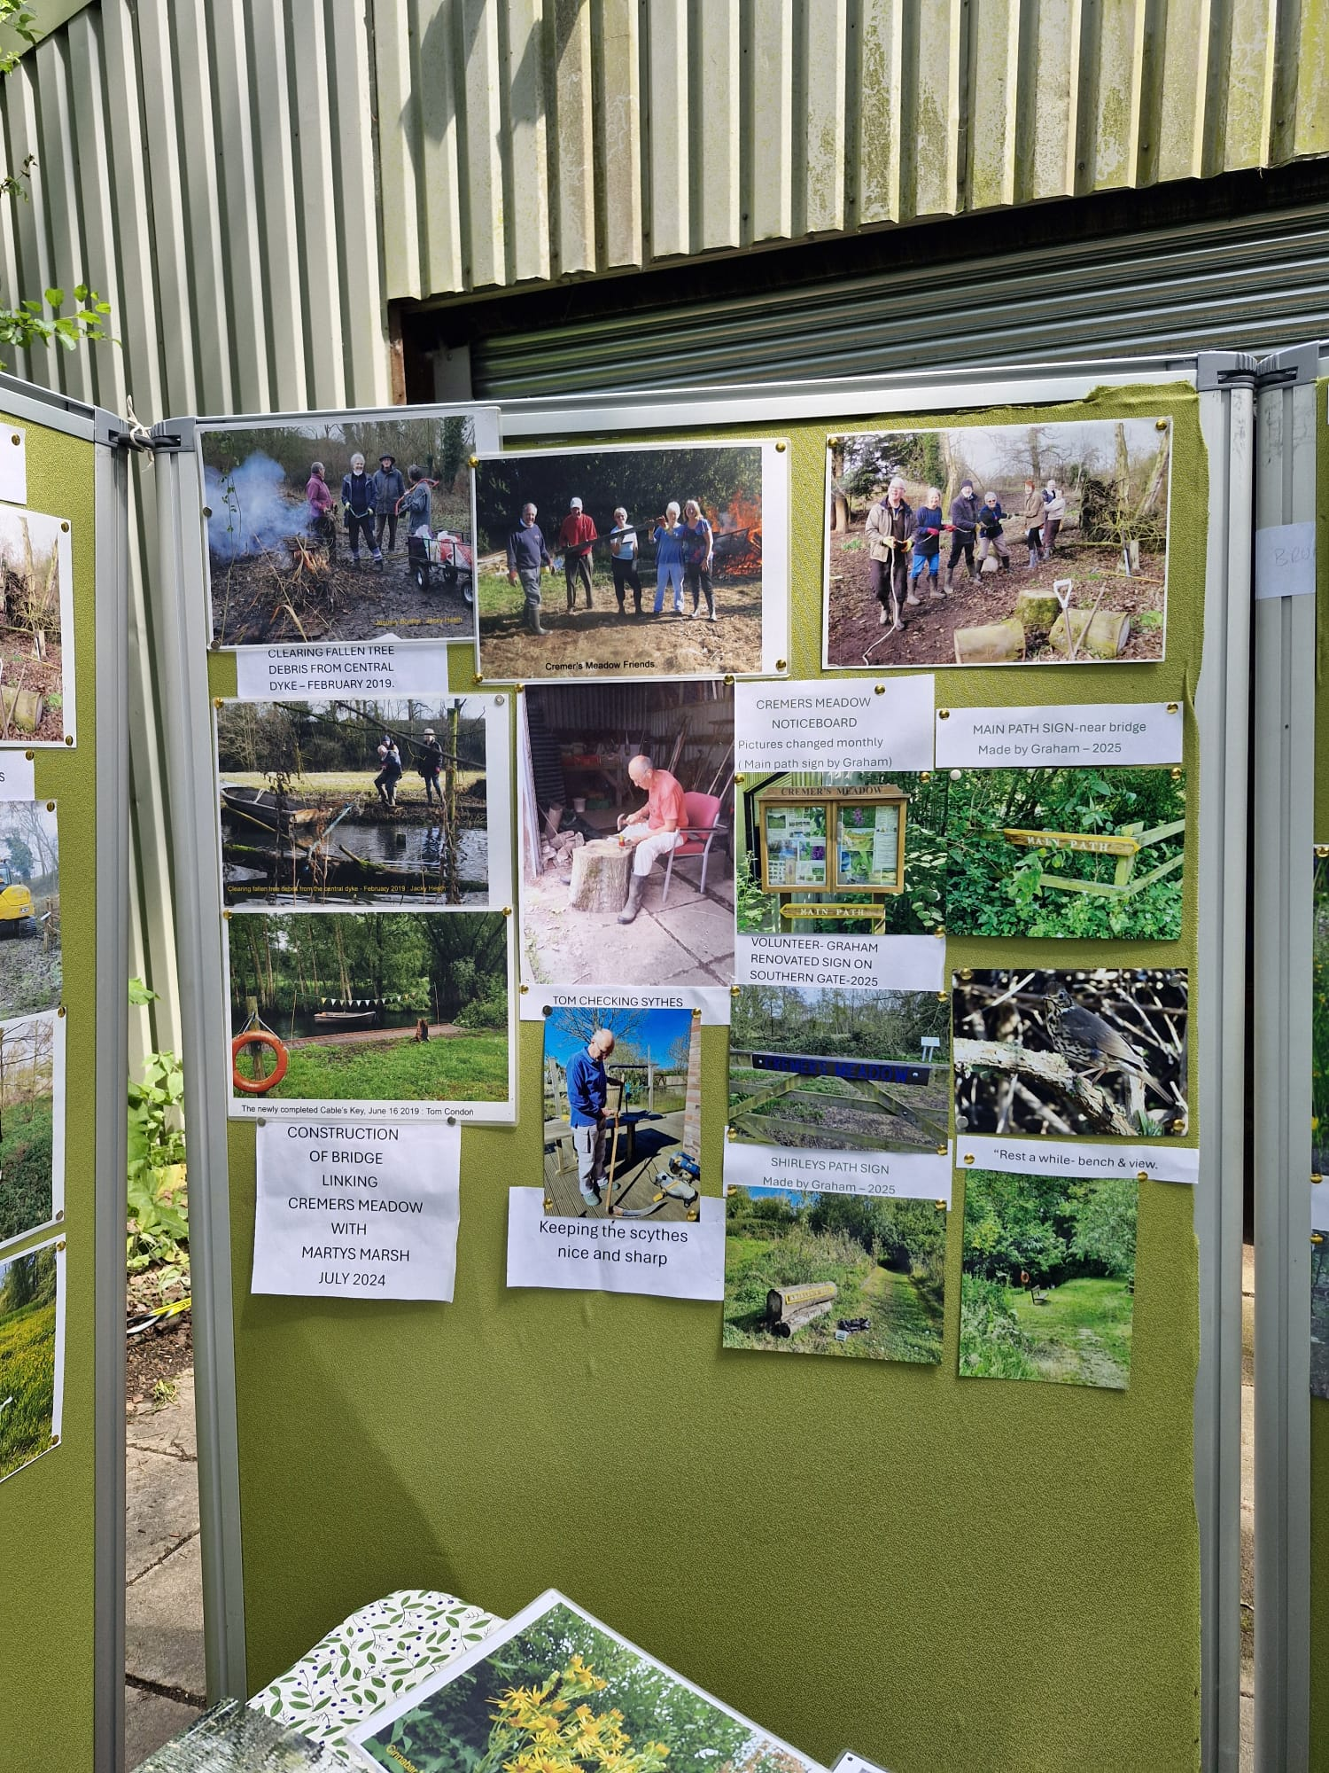
Displays and activities made it an enjoyable day.

Slide 8
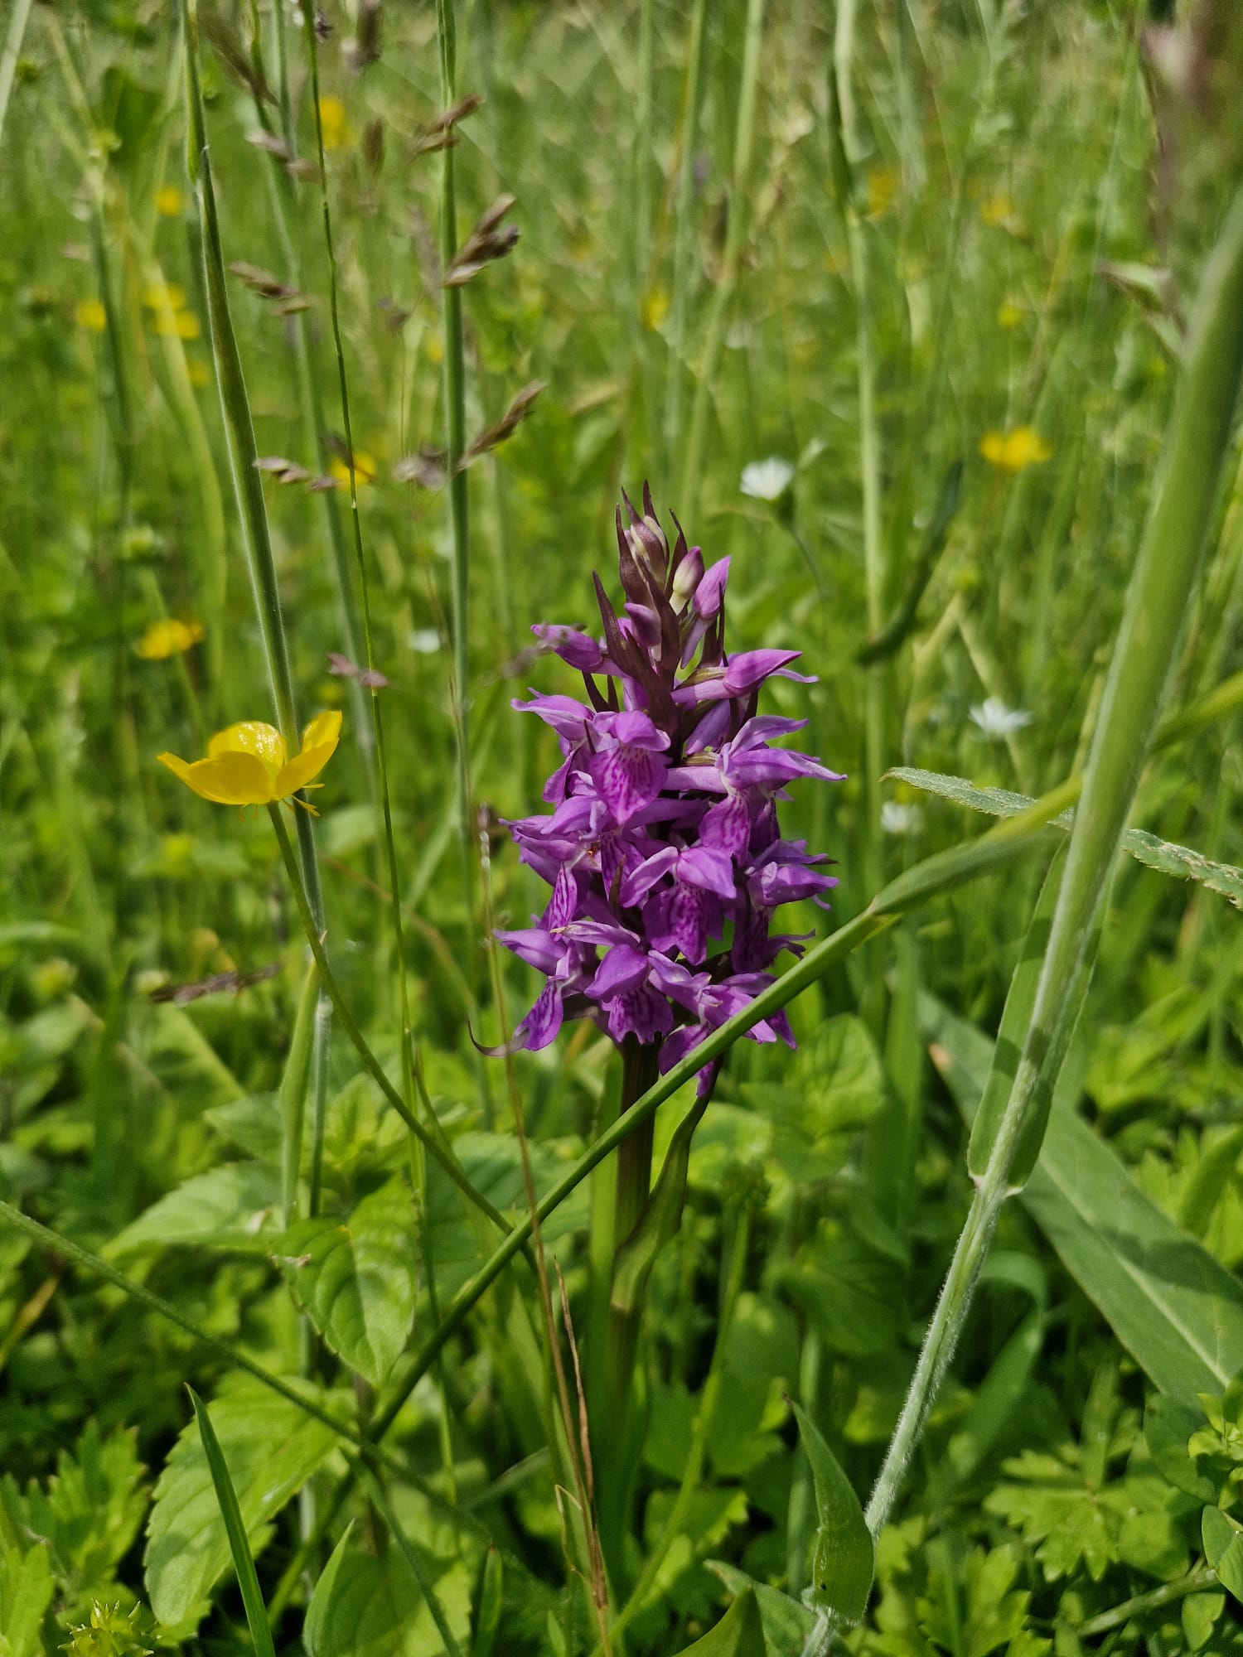
Our famous Southern Marsh Orchid

Slide 9
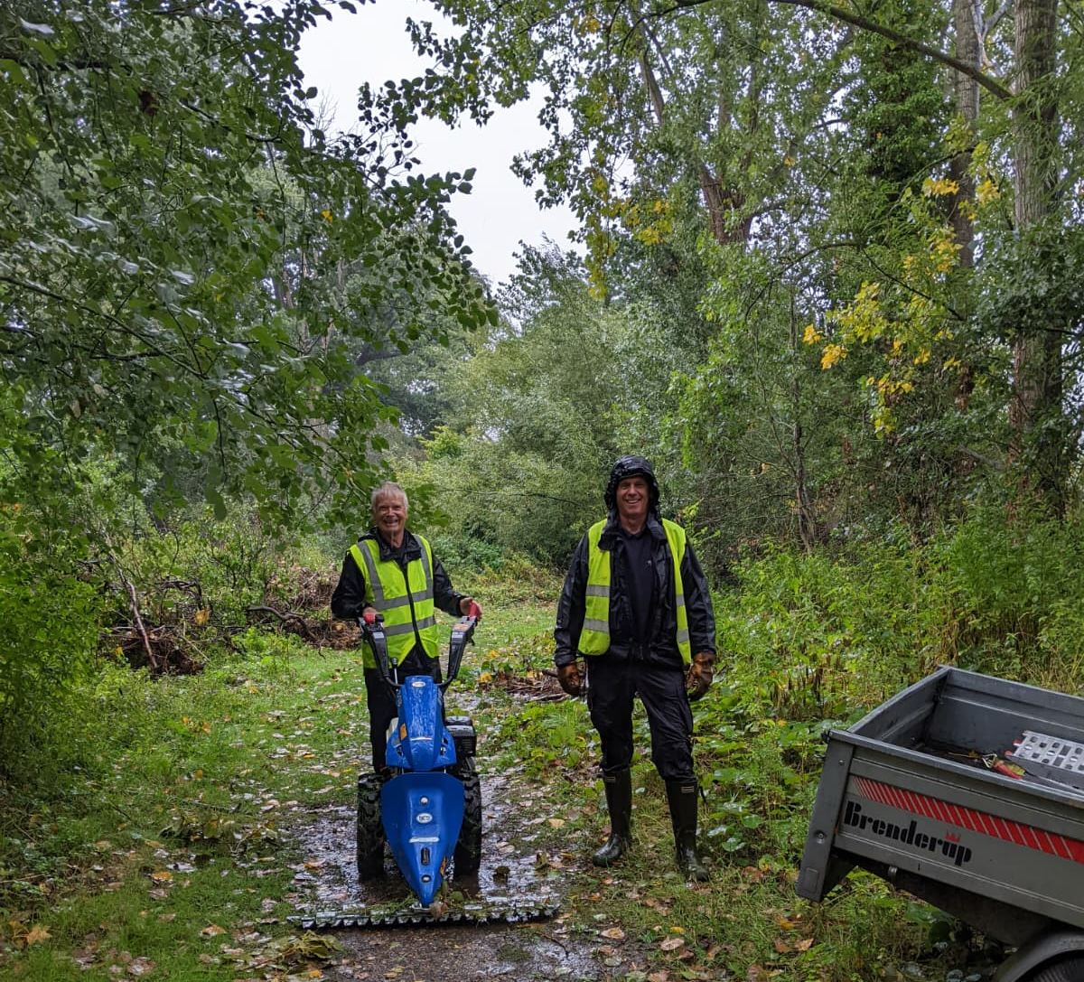
Cut and Clear September 2025.
Friends from Bure Valley Conservation and BADCOG help us out.

Slide 10
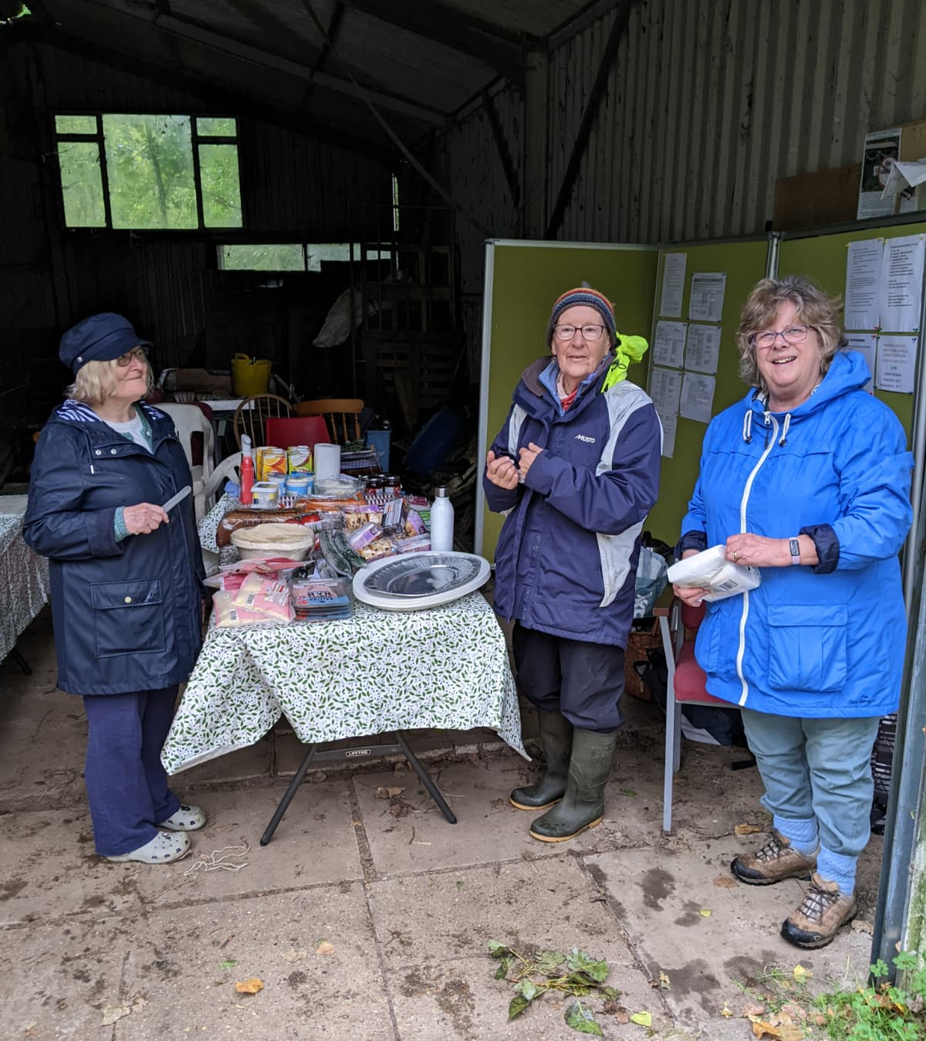
Thanks to the Central Co-op for welcome refreshments.

Slide 11
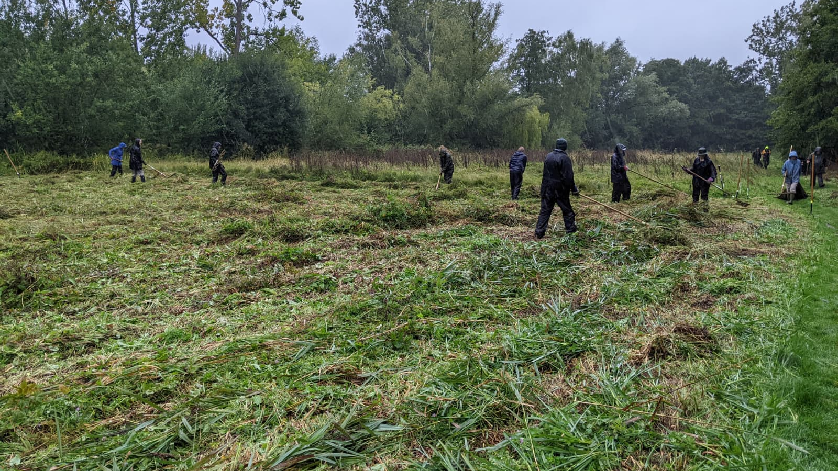

Slide 12
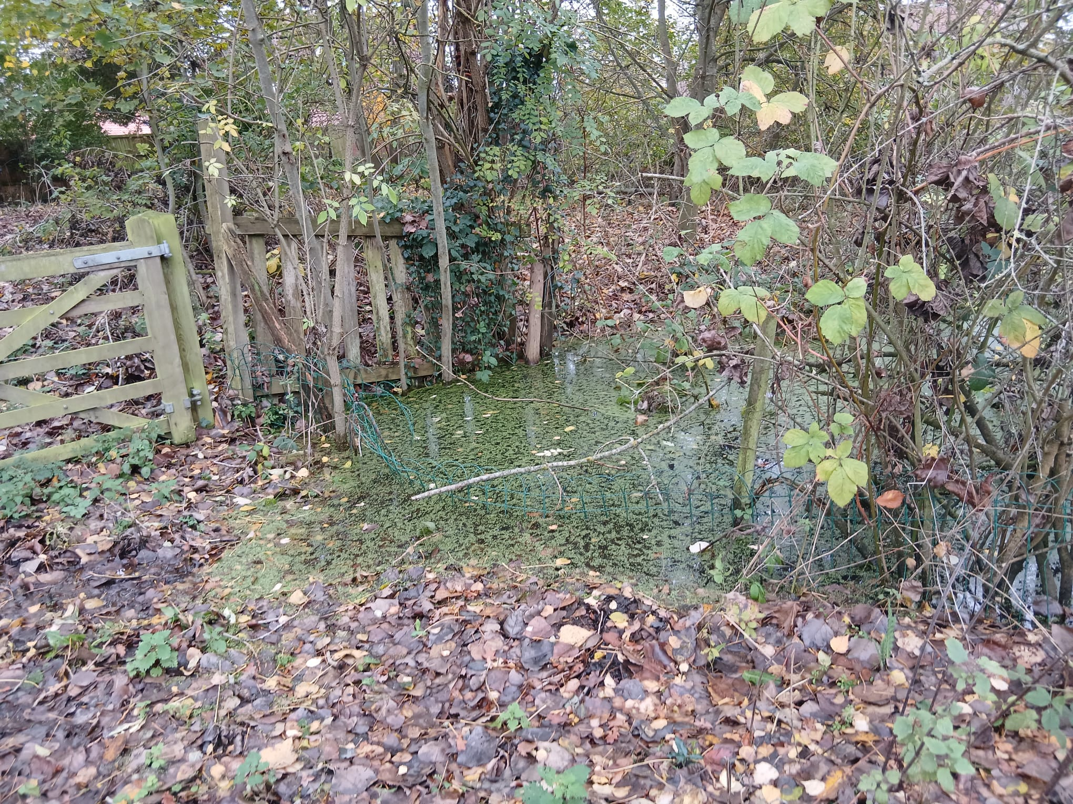
Too much water!

Slide 13
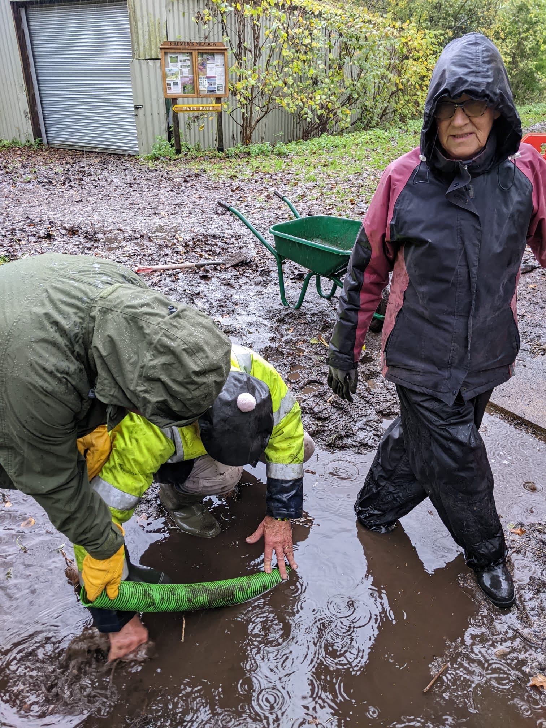
Friends to the rescue.

Slide 14
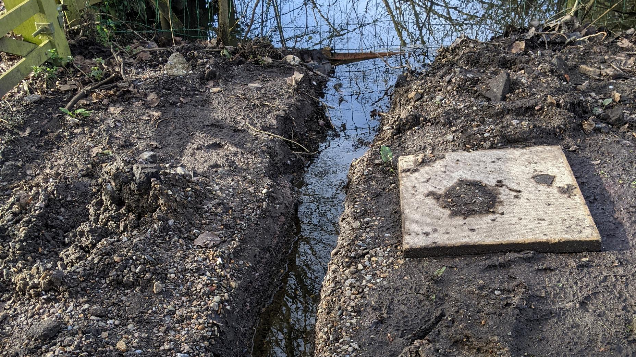

Slide 15
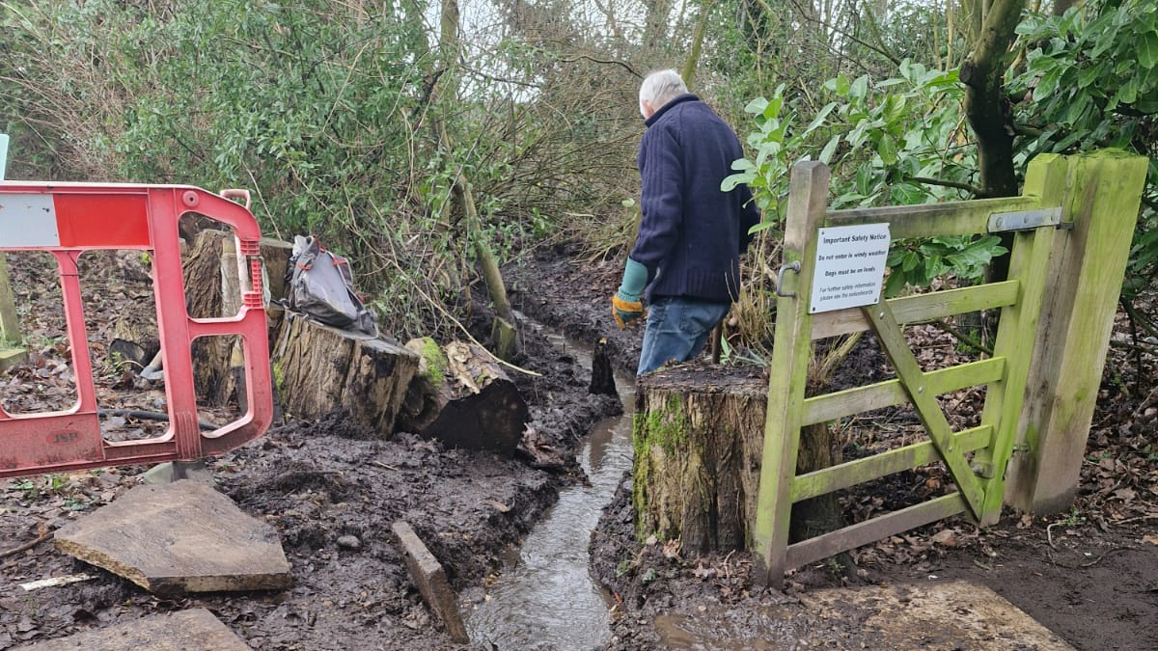

Slide 16
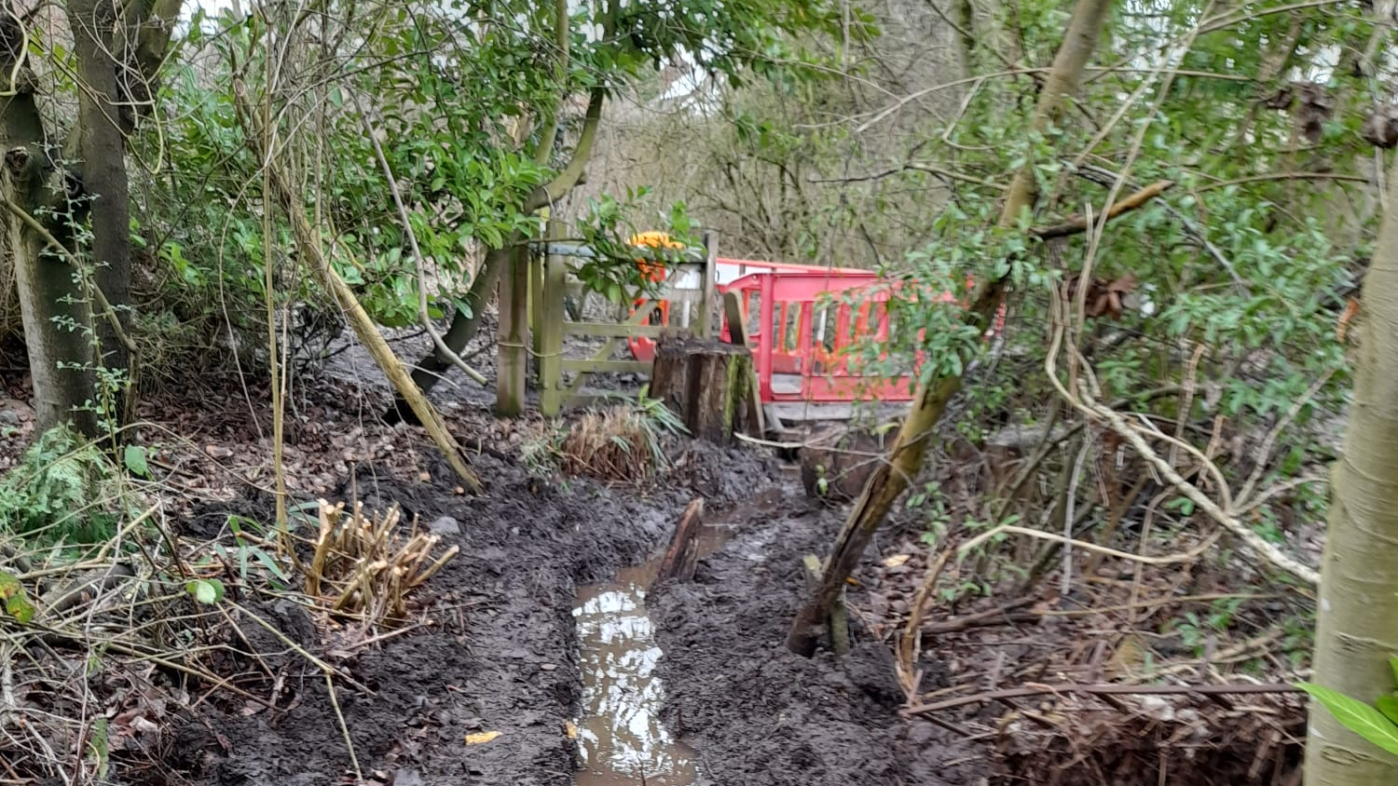

Slide 17
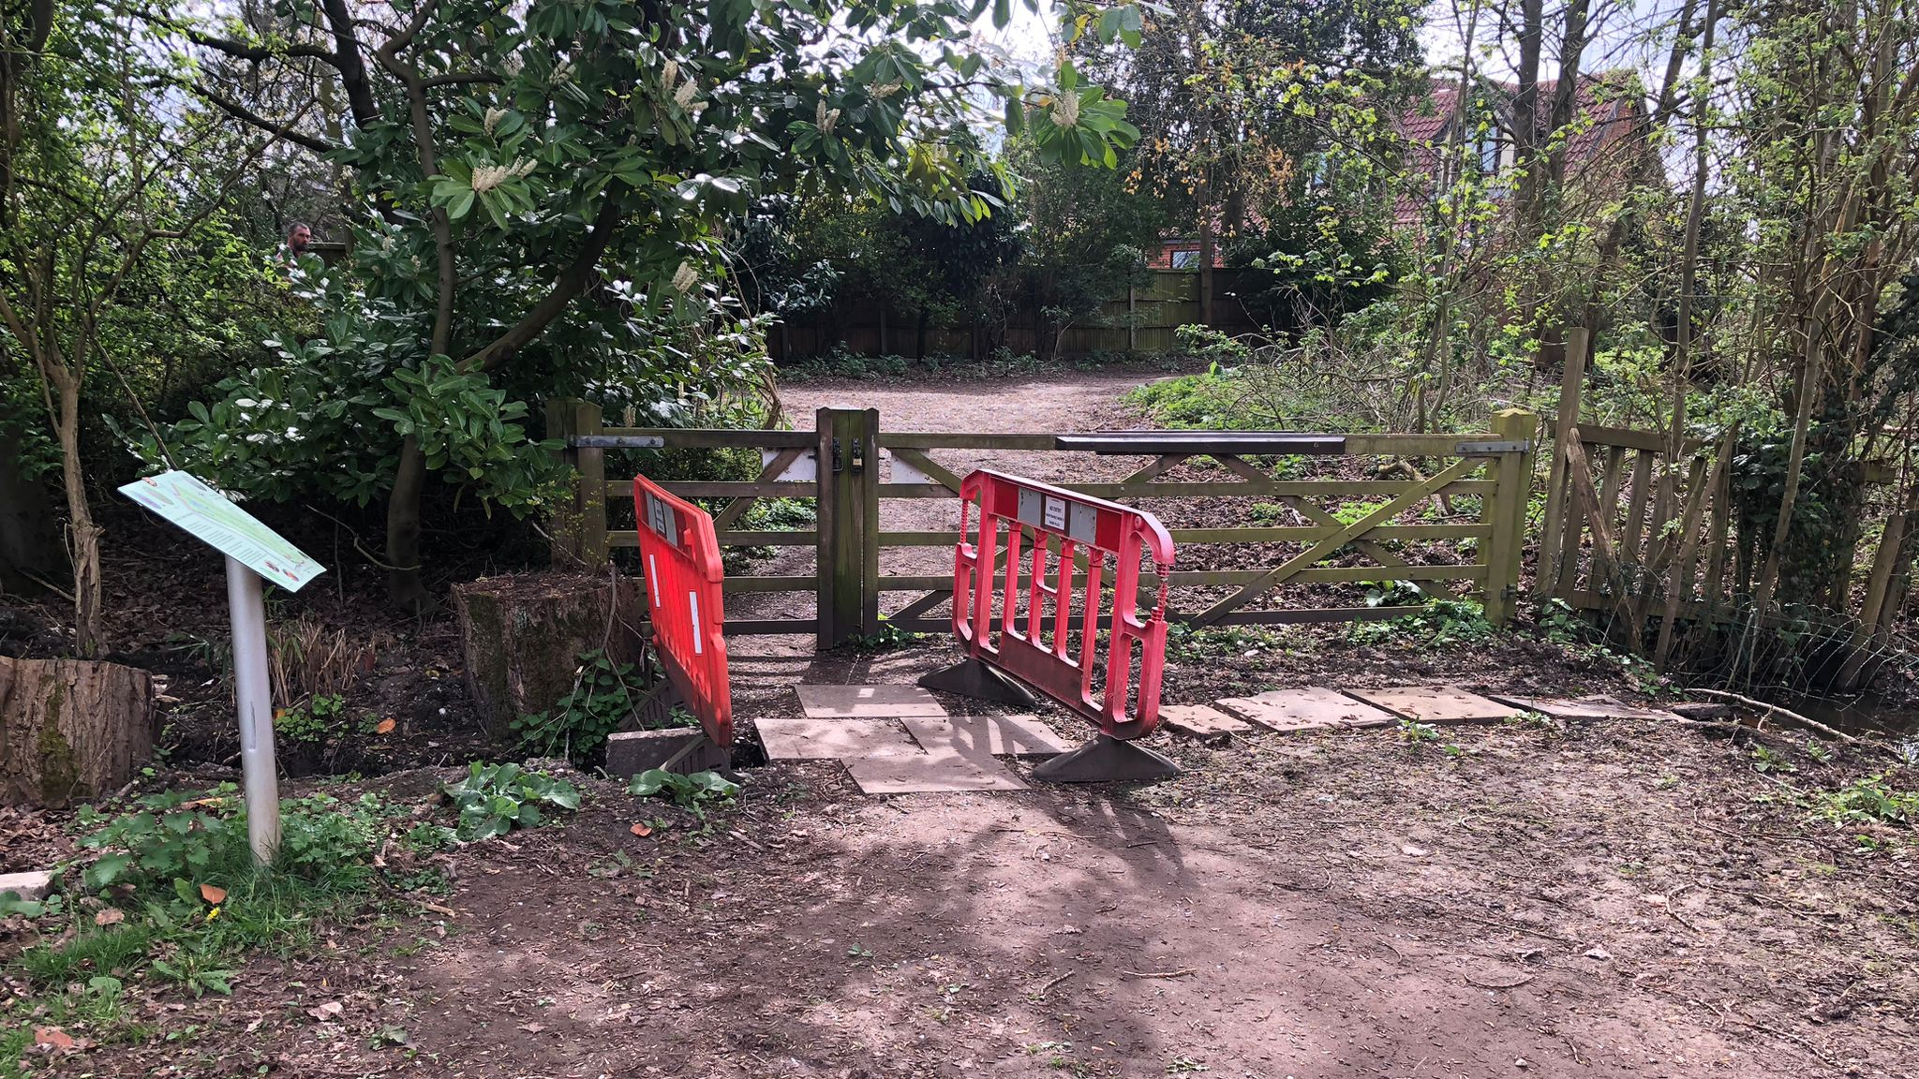

Slide 18
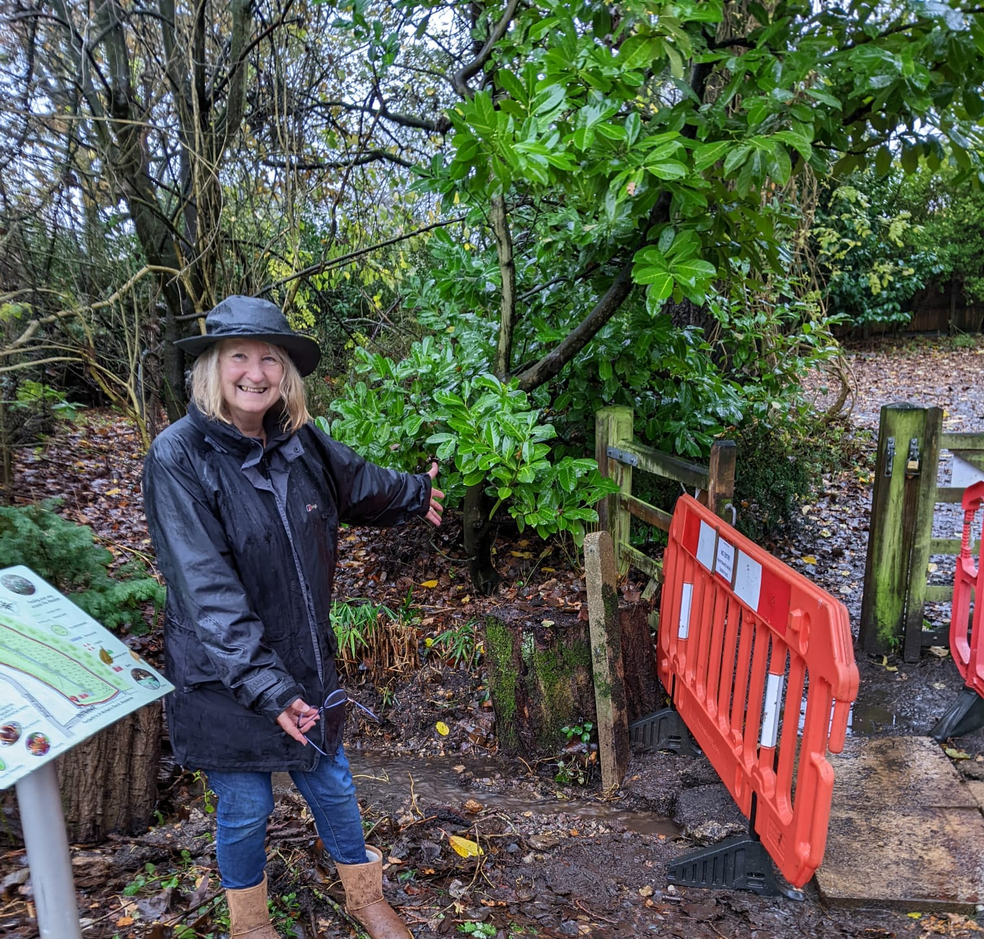
Always a solution from the Friends.

Slide 19
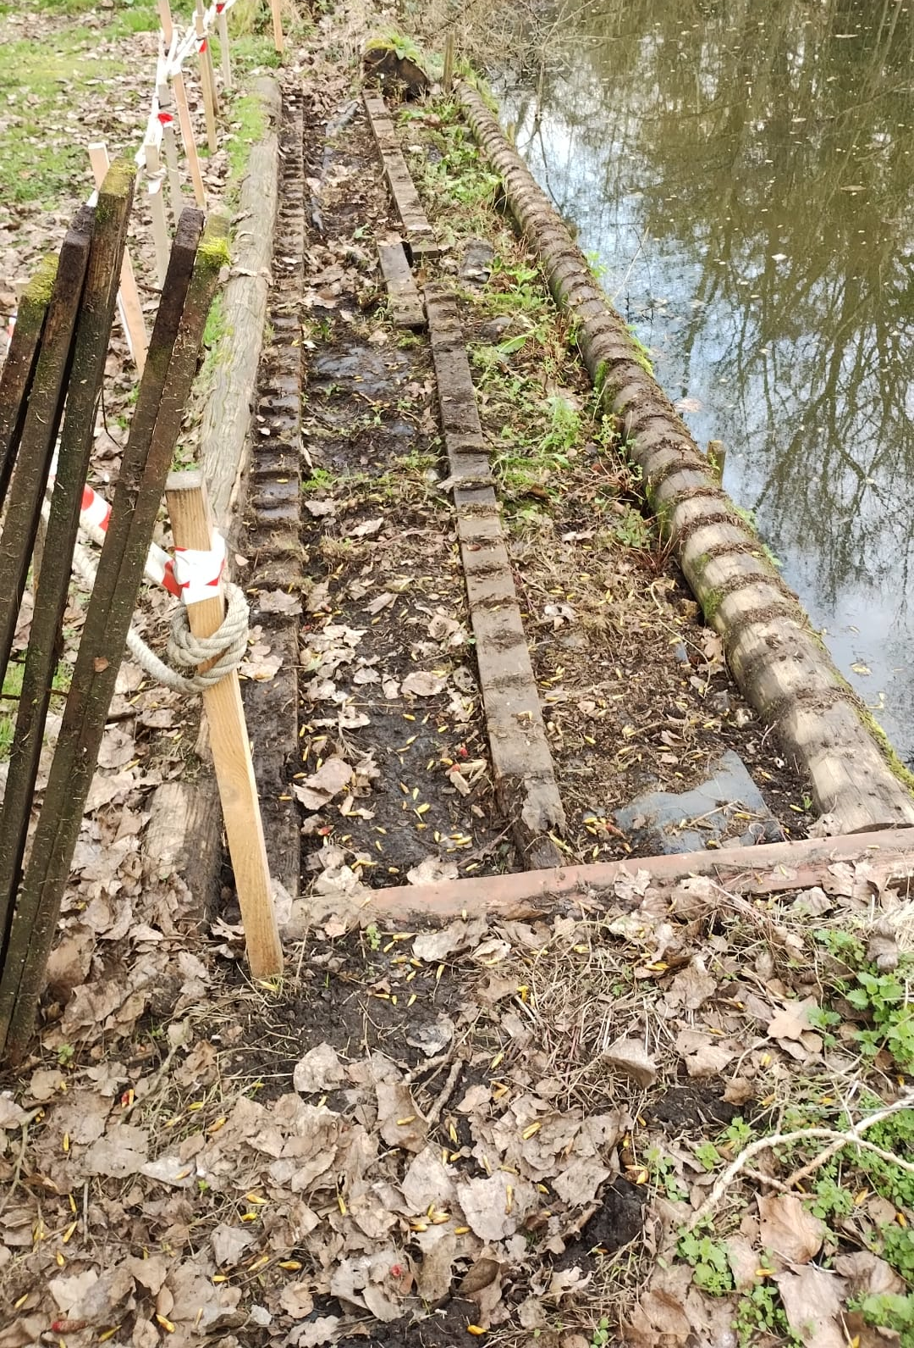
The quay required refurbisment

Slide 20
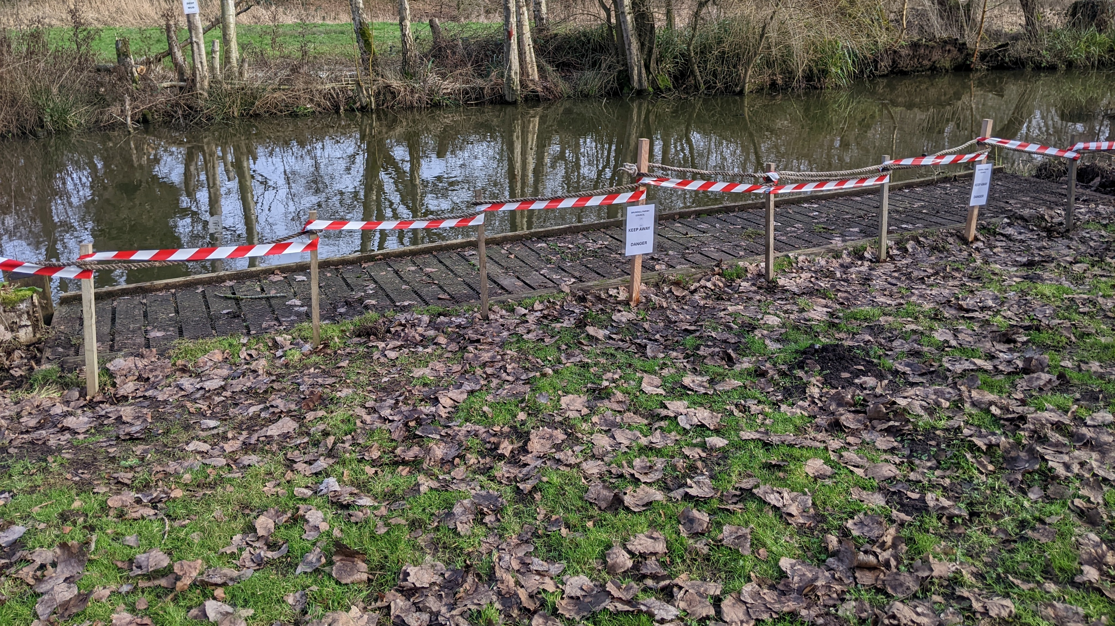

Slide 21
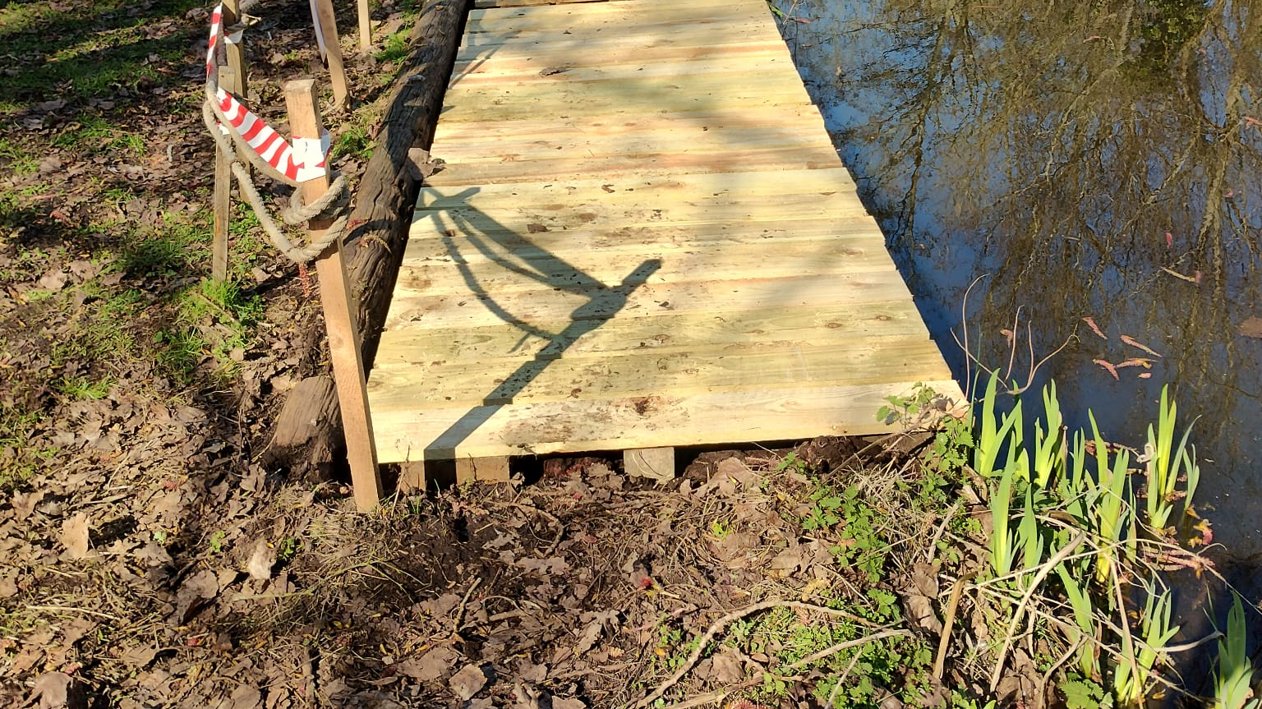

Slide 22
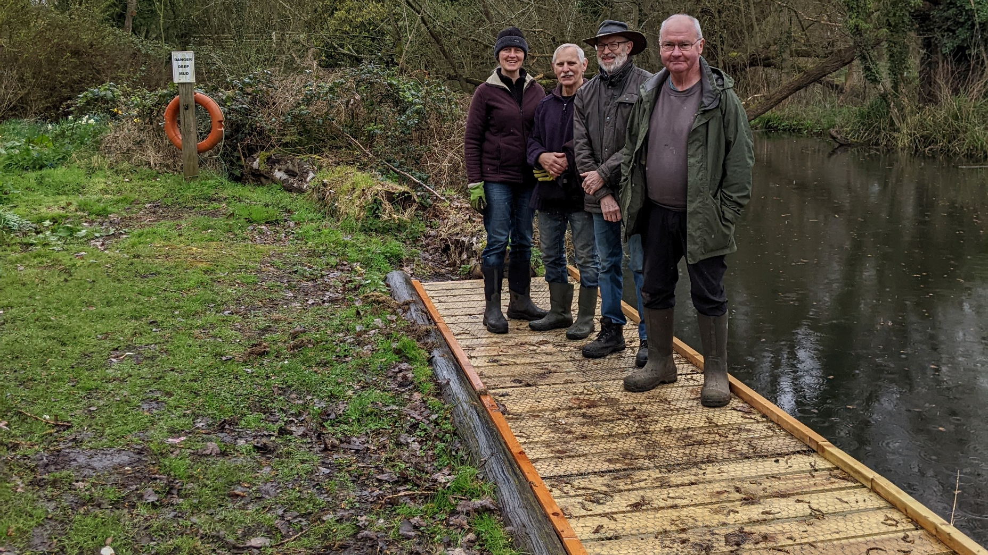

Slide 23
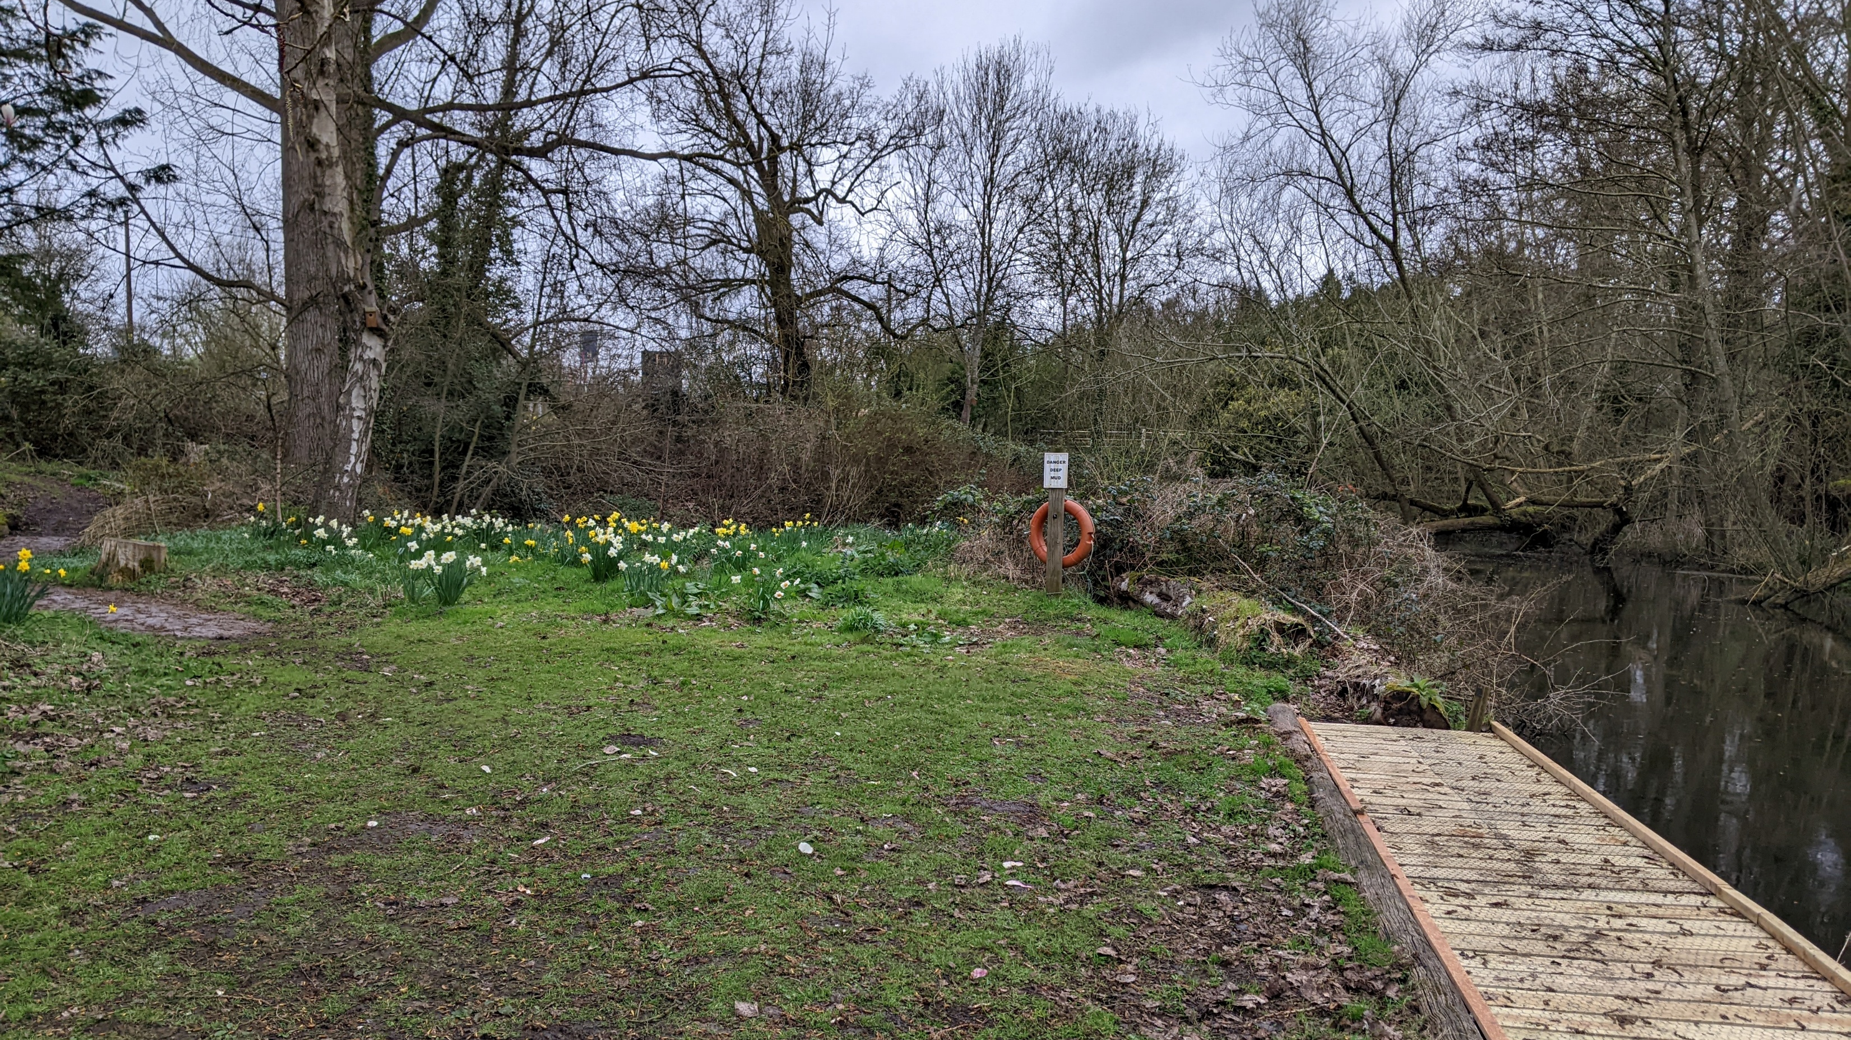

Slide 24
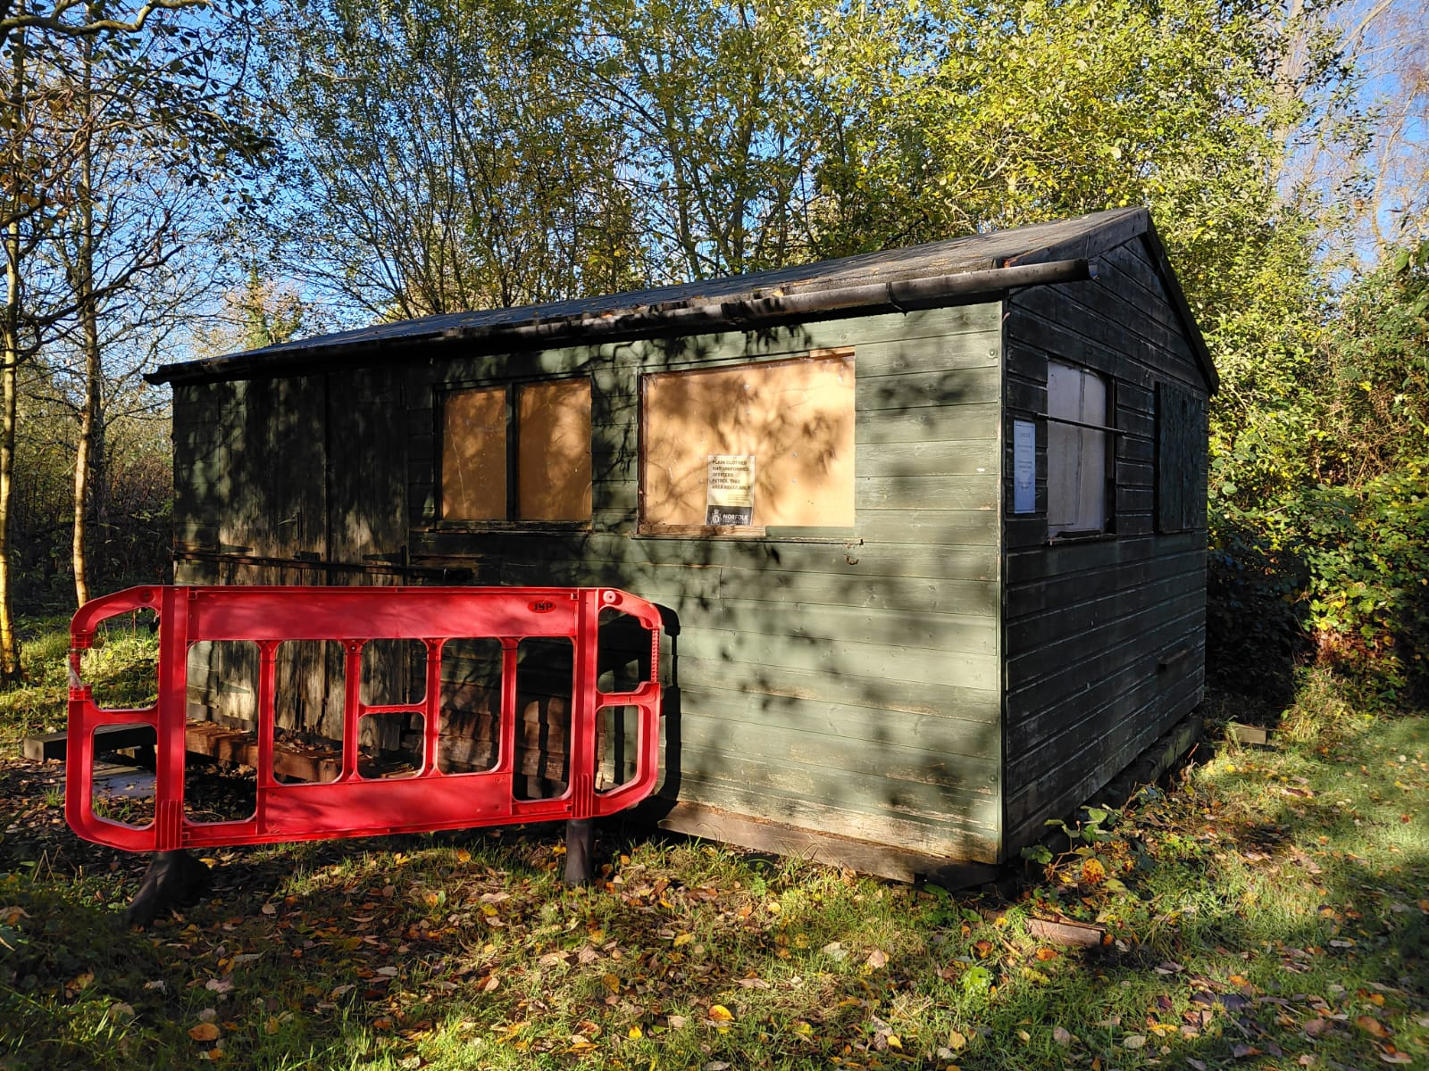
There is still quite a lot of work required to repair the Information Hut.

Slide 25
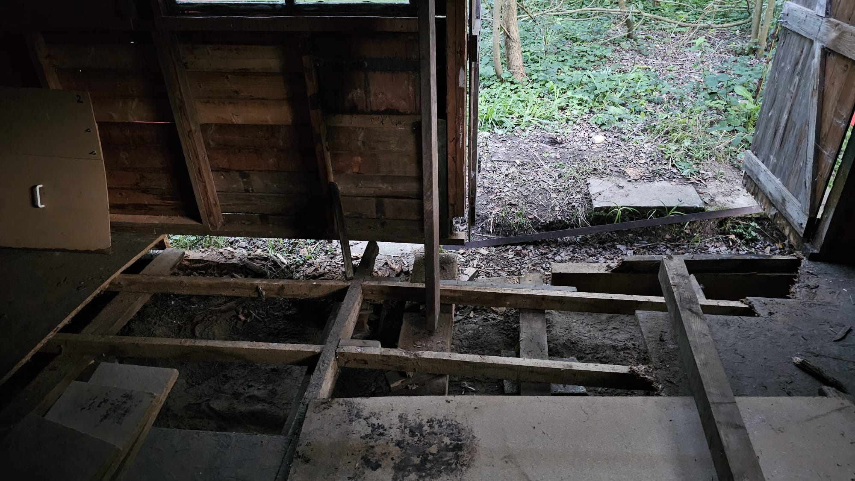

Slide 26
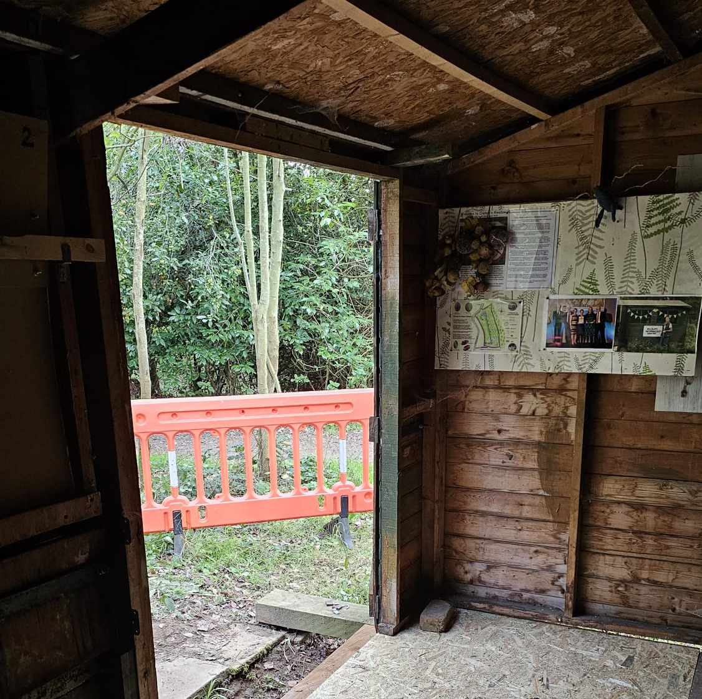
Lots of progress has been made and hopefully it will be finished in time for the Open Day on June 20th

Slide 27
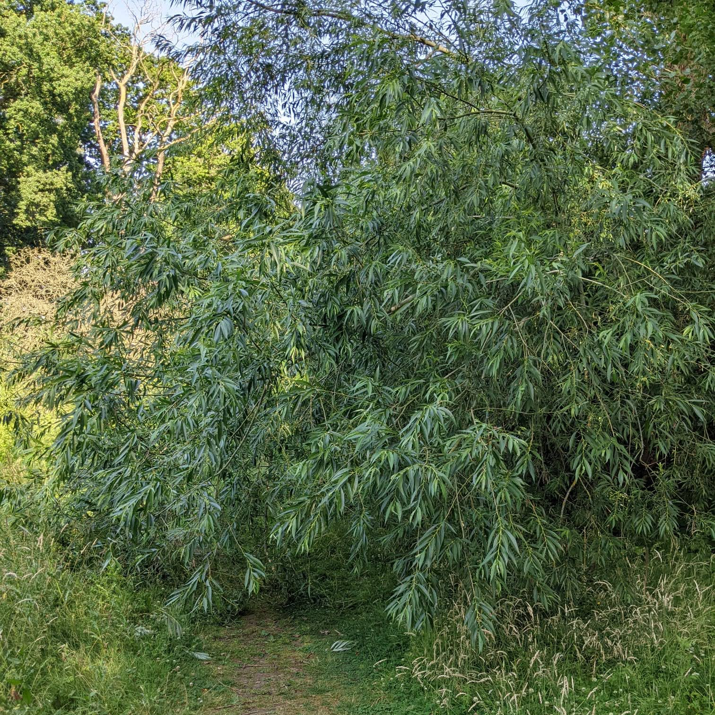
One fallen tree this year.

Slide 28
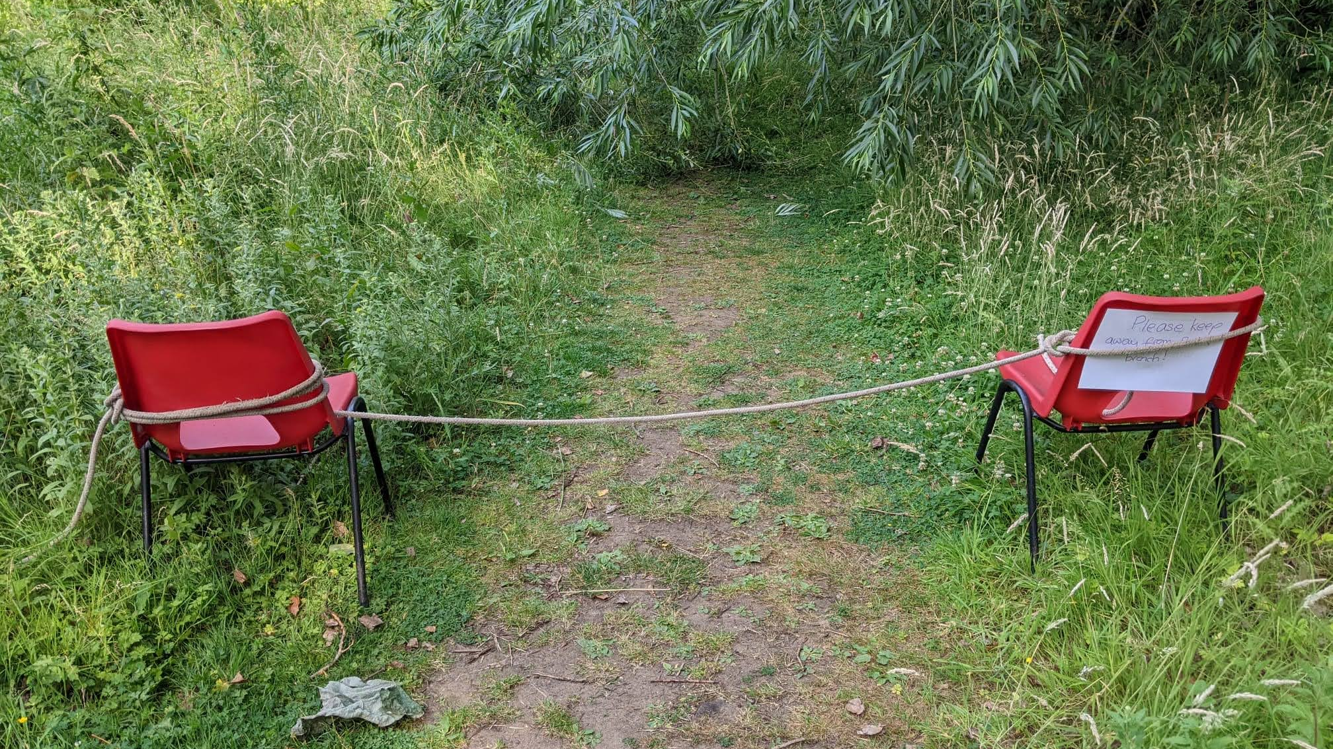
Temporary solution!

Slide 29
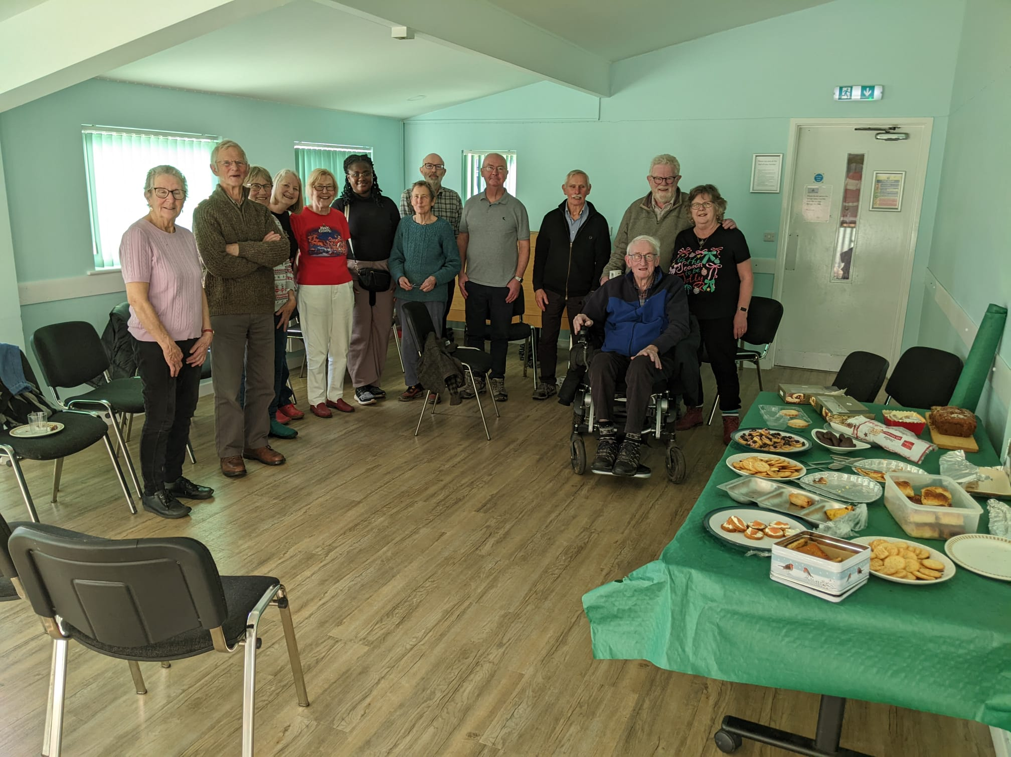
Christmas celebration lunch.

Slide 30
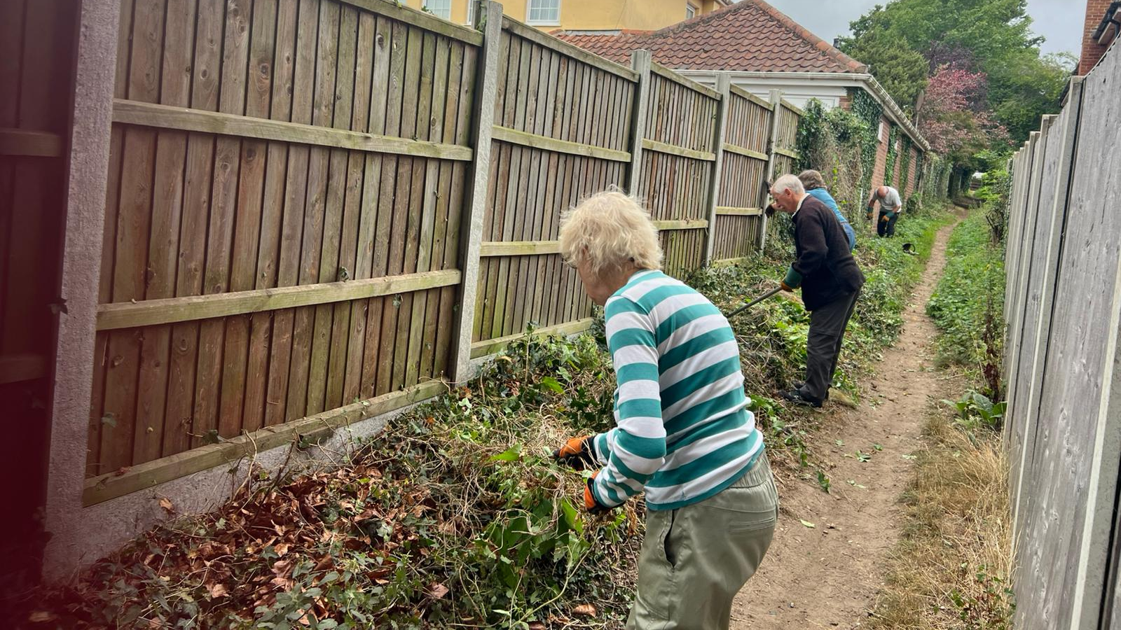
Cremer’s in the community.

Slide 31
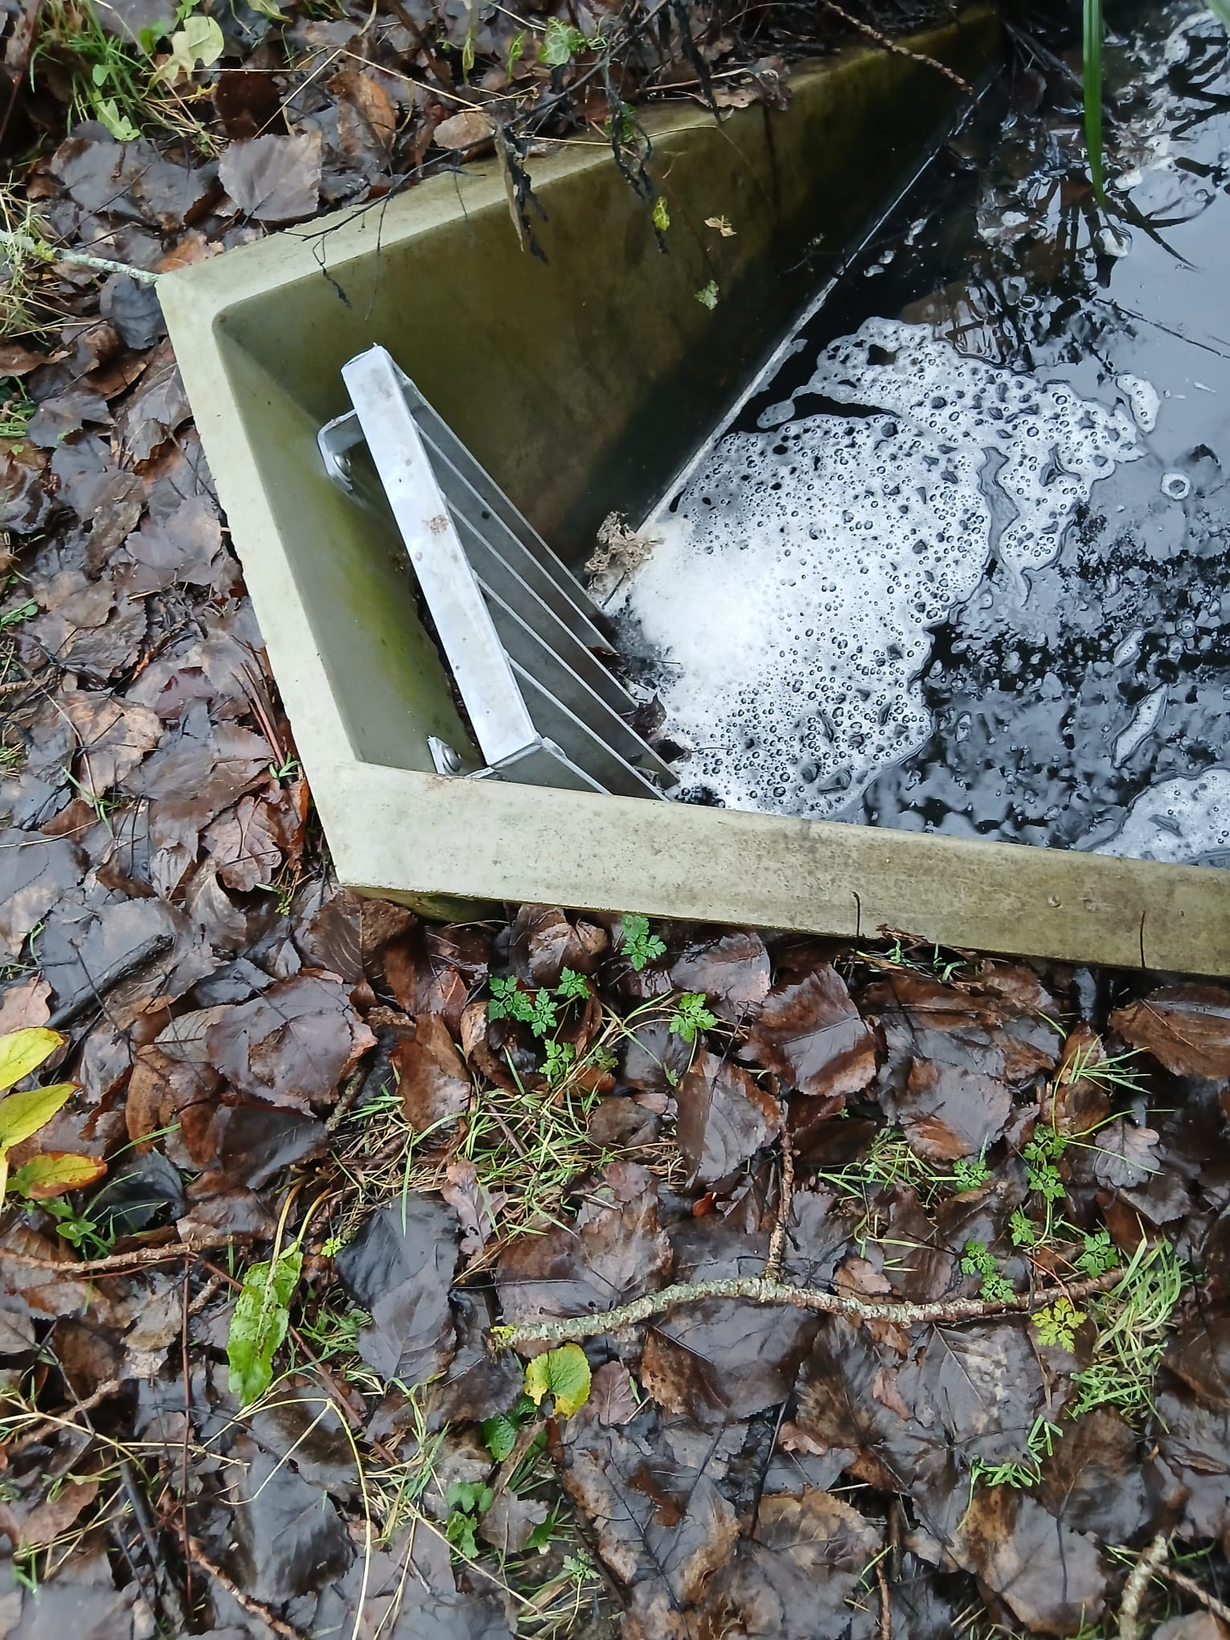
The sluice continues to work well allowing us to have a controlled pond.

Slide 32
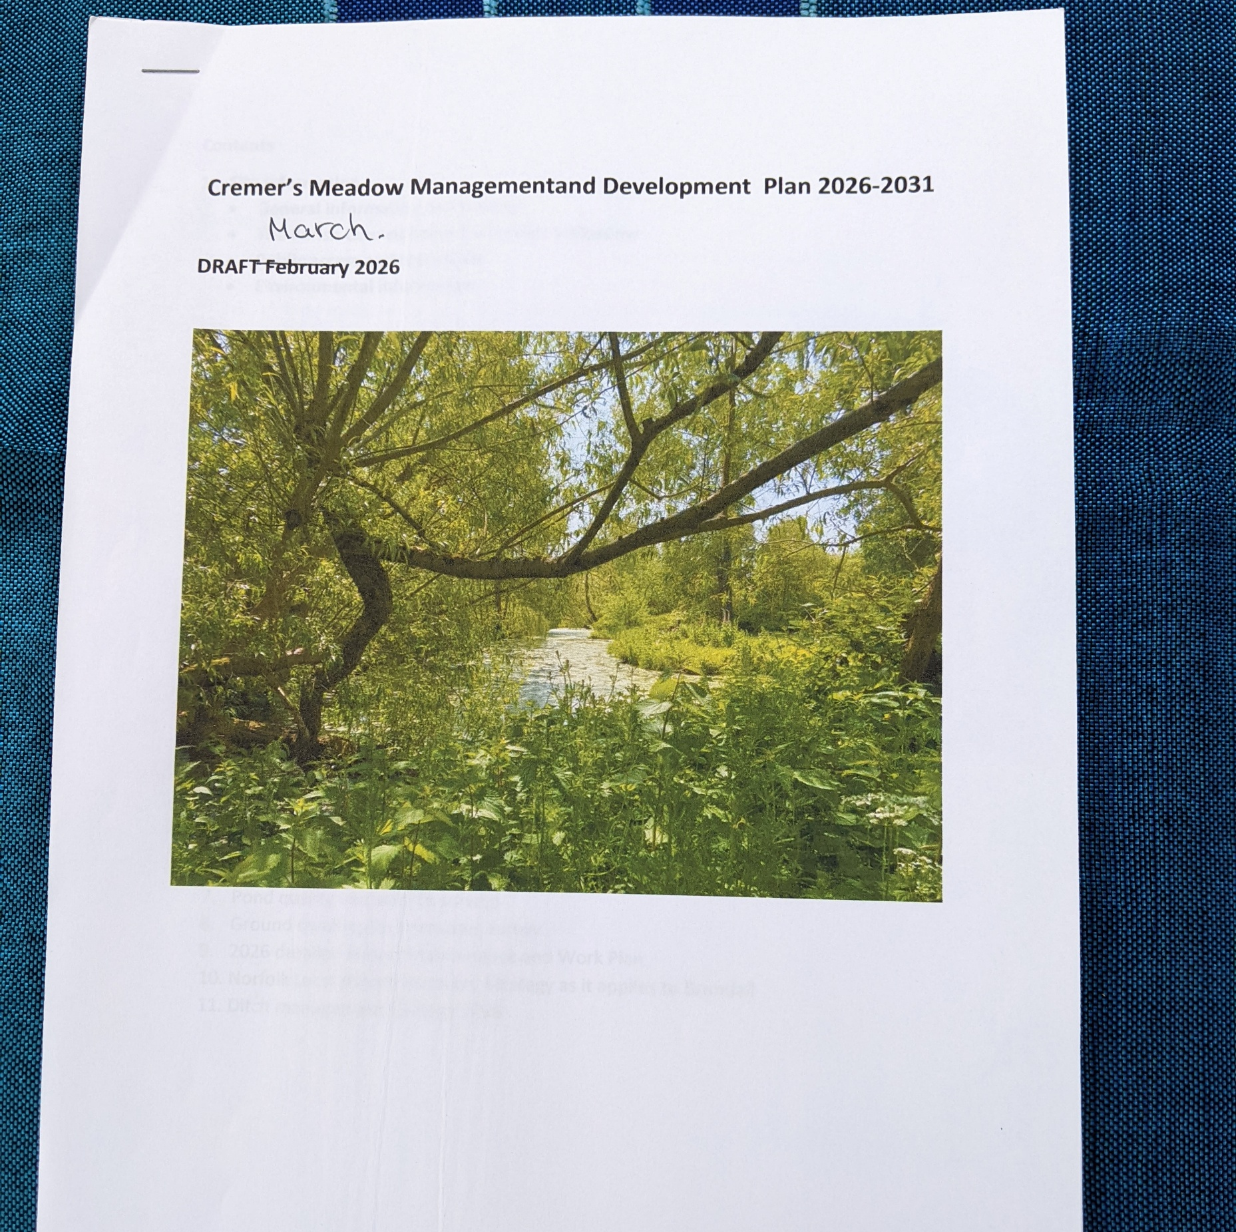
The new 5 year plan is almost in place.

Slide 33
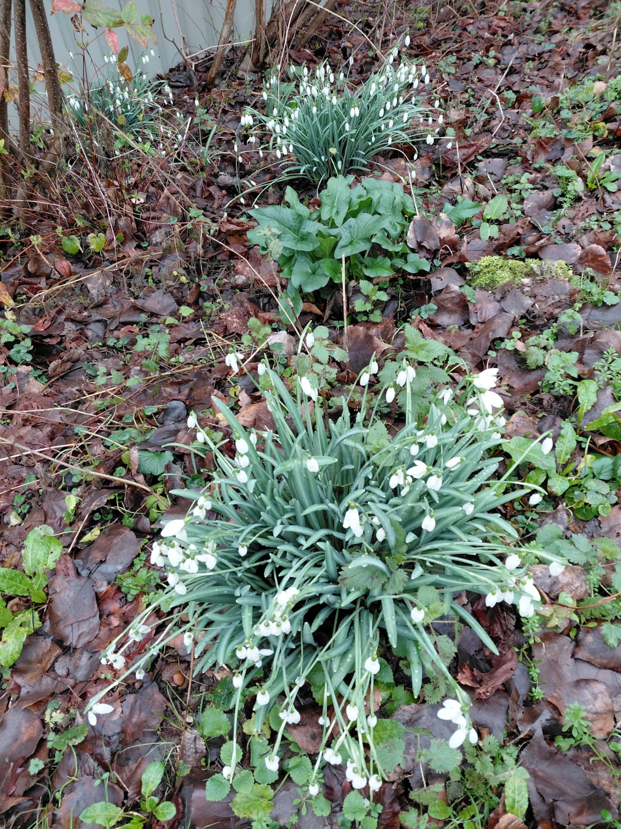
Nature and biodiversity remain the key aims of Cremer’s Meadow.

Slide 34
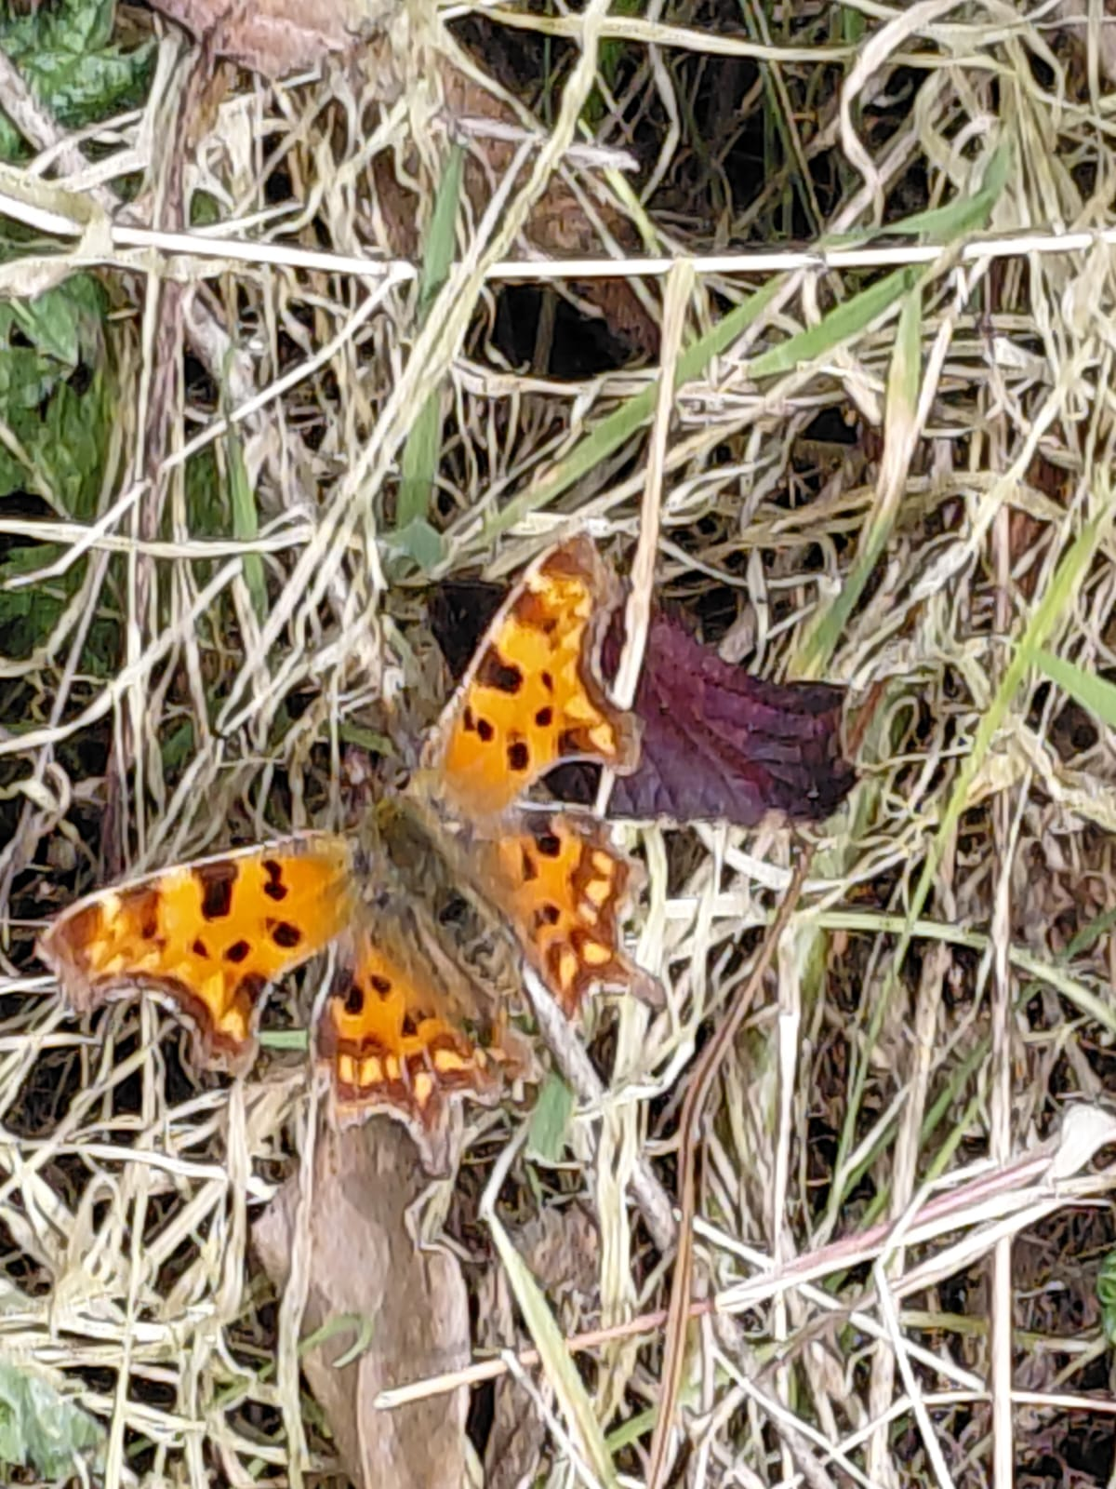

Slide 35
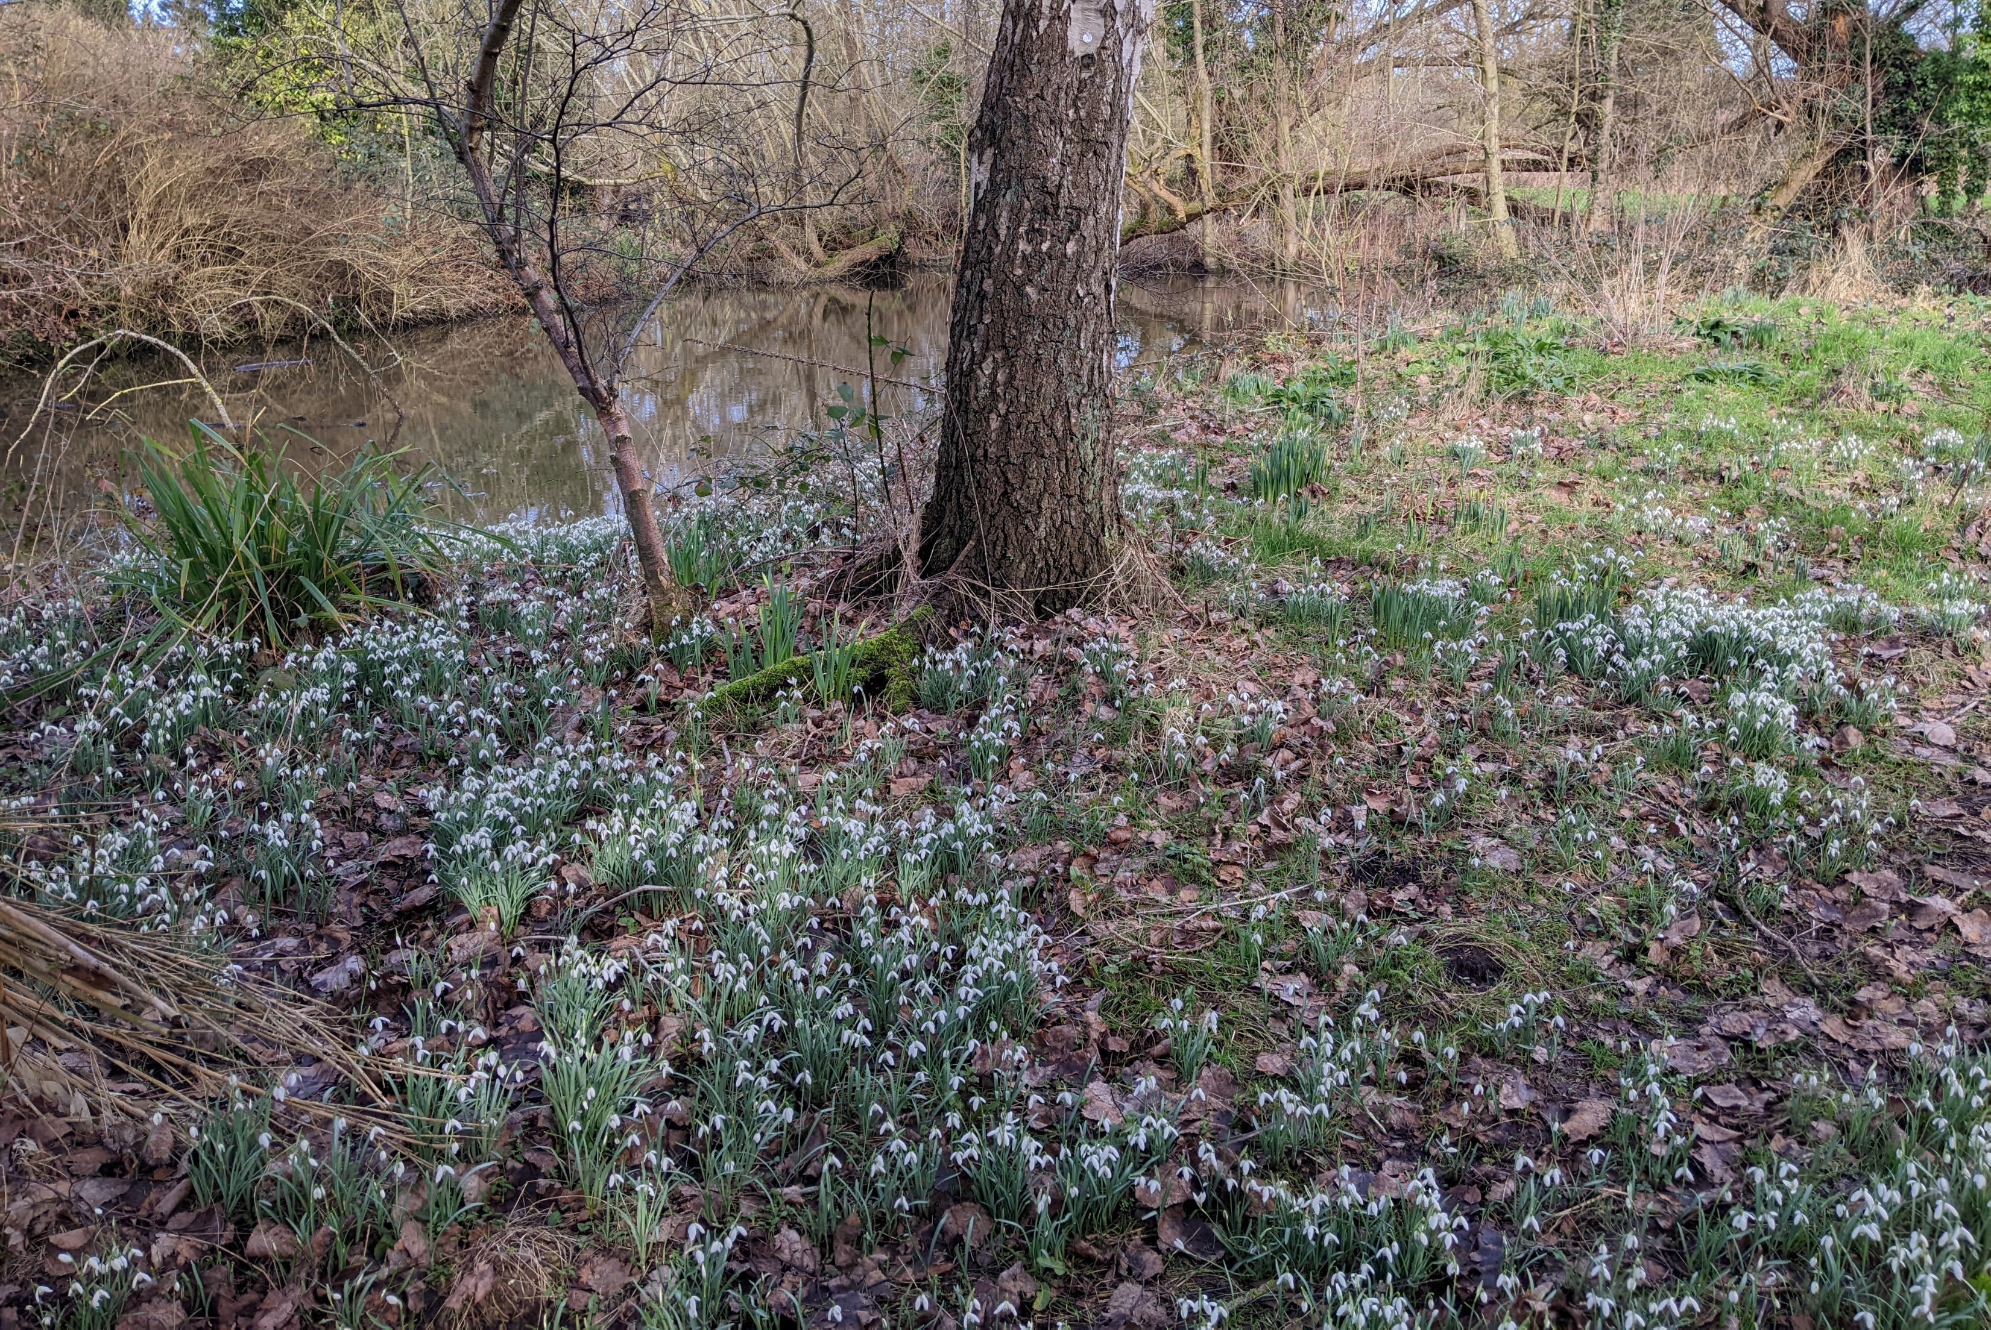

Slide 36
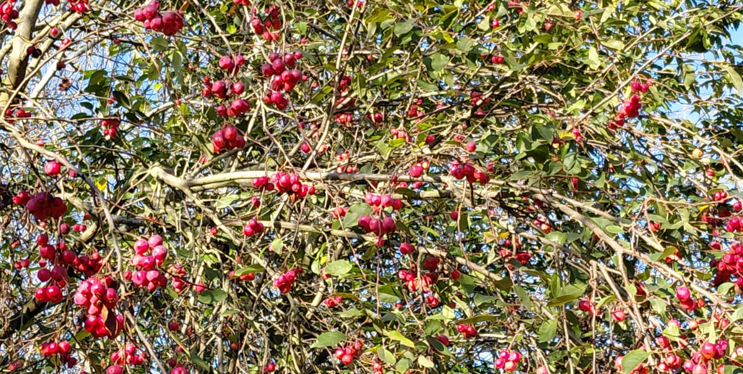

Slide 37
